Slide 1
Wearables in Healthcare Technologies

Slide 2
Introduction to Wearables
1. Introduction to Wearables for Physiological Applications
Applications:
Overview of Wearable Sensors for Health Monitoring
Types of Sensors
Challenges
Definition of Wearables
Highlights of Wearables in Healthcare Technologies
Notes:
Here is a detailed response tailored to your expertise in wearable technology:
1. Introduction to Wearables for Physiological Applications
Wearable technology for physiological applications refers to devices that can be worn on the body to monitor, collect, and analyze data related to human health and physiology. These devices are pivotal in transforming healthcare by providing real-time data that can lead to better health management, early detection of diseases, and personalized medical interventions. Wearables range from simple fitness trackers to sophisticated devices capable of measuring complex physiological markers like blood glucose levels, heart rate variability, and even brain activity through EEG (electroencephalogram) sensors.
Applications:
Fitness and Activity Tracking: Monitoring steps, calories, and activity levels.
Health Monitoring: Continuous tracking of vital signs like heart rate, blood pressure, oxygen saturation.
Chronic Disease Management: Helping manage conditions like diabetes, hypertension, or sleep disorders.
Rehabilitation: Assisting in physical therapy by monitoring movement and progress.
2. Overview of Wearable Sensors for Health Monitoring
Wearable sensors are the core components that make physiological monitoring possible. Here's an overview:
Types of Sensors:
Electrocardiogram (ECG) Sensors: Monitor heart rhythm and detect arrhythmias.
Photoplethysmography (PPG) Sensors: Measure blood volume changes in microvascular bed of tissue, used for heart rate monitoring.
Accelerometers and Gyroscopes: Track movement to analyze physical activity, posture, and falls.
Temperature Sensors: Monitor body temperature, useful for fever detection or thermoregulation studies.
Biochemical Sensors: Detect specific substances like glucose or lactate in body fluids.
Electromyography (EMG) Sensors: Measure electrical activity produced by skeletal muscles, useful in muscle function analysis.
Electroencephalography (EEG) Sensors: Used in headbands or hats to measure brain activity for cognitive health or sleep analysis.
Challenges:
Accuracy in diverse environmental conditions.
Power management for long-term wear.
Data privacy and security.
Integration and miniaturization for comfort and aesthetics.
3. Definition of Wearables
Wearables are electronic devices that are designed to be worn on the human body, which can include accessories like watches, glasses, clothing, or even implants. They often incorporate sensors, microprocessors, and connectivity features (like Bluetooth or Wi-Fi) to collect data, perform computations, and interact with other systems or the user directly. The primary purpose in a physiological context is to monitor health metrics, provide feedback, or act as an interface for health-related applications.
4. Highlights of Wearables in Healthcare Technologies
Preventive Healthcare: Wearables encourage proactive health management by providing insights into daily health metrics, potentially preventing severe health issues through early detection.
Remote Patient Monitoring: Allows doctors to monitor patients' health remotely, reducing hospital visits, especially beneficial for chronic care or post-operative monitoring.
Personalized Medicine: With the data collected, treatments and medications can be tailored more precisely to the individual's health profile.
Mental Health: Devices that monitor sleep patterns, stress levels, or even use biofeedback for anxiety management are becoming more prevalent.
Research and Development: Wearables provide vast amounts of data for longitudinal studies, aiding in the development of new treatments or understanding disease patterns better.
Integration with IoT: Wearables are increasingly part of a larger Internet of Things ecosystem where they can interact with home devices to create a supportive health environment.
Ethical and Legal Considerations: With the rise of wearables, there's an ongoing discussion about data ownership, privacy, and consent in healthcare data usage.
This overview should give a comprehensive look into how wearables are shaping the future of health technology, resonating with your background in embedded systems and patent innovation in this field.

Slide 3
Essential parameters for diagnosing patient body.
When diagnosing a patient, healthcare providers typically look at several key physiological parameters that can give insights into various health conditions:
Vital Signs:
Heart Rate (HR): Indicates cardiovascular health, stress levels, or physical exertion.
Blood Pressure (BP): High or low readings can suggest hypertension, hypotension, or cardiovascular issues.
Respiratory Rate (RR): Can reflect conditions like pneumonia, anxiety, or metabolic acidosis.
Body Temperature: Fever or hypothermia can indicate infections, inflammation, or issues with thermoregulation.
Oxygen Saturation (SpO2): Low levels might point to respiratory problems or circulatory issues.
Electrocardiogram (ECG/EKG): Provides detailed information about heart rhythm, conduction, and potential cardiac abnormalities.
Blood Glucose Levels: Critical for diagnosing and managing diabetes.
Electrolyte Levels: Sodium, potassium, calcium, etc., imbalances can lead to a variety of symptoms and health issues.
Blood Parameters: Including complete blood count (CBC), which can show anemia, infection, or leukemia.
Physical Activity Levels: Can indicate general health, recovery status, or musculoskeletal health.
Sleep Patterns: Disruptions might relate to sleep disorders, stress, or other underlying health conditions.
Body Composition: BMI, body fat percentage, muscle mass, which relate to nutritional status, obesity, or metabolic health.
Hydration Status: Through urine analysis or skin turgor tests.

Slide 4
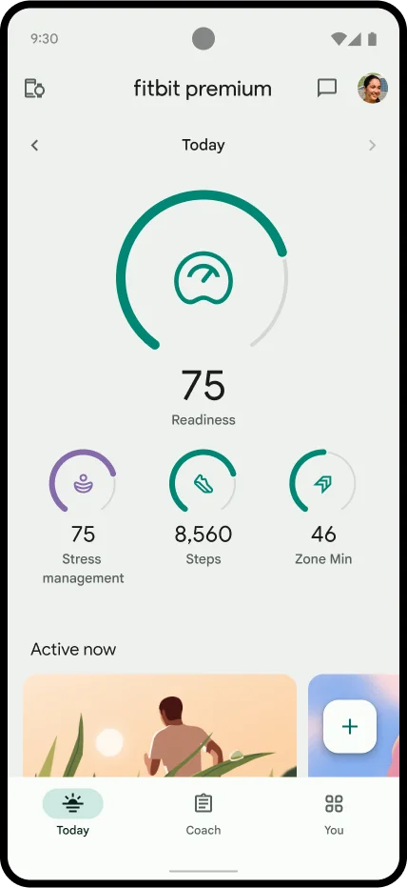
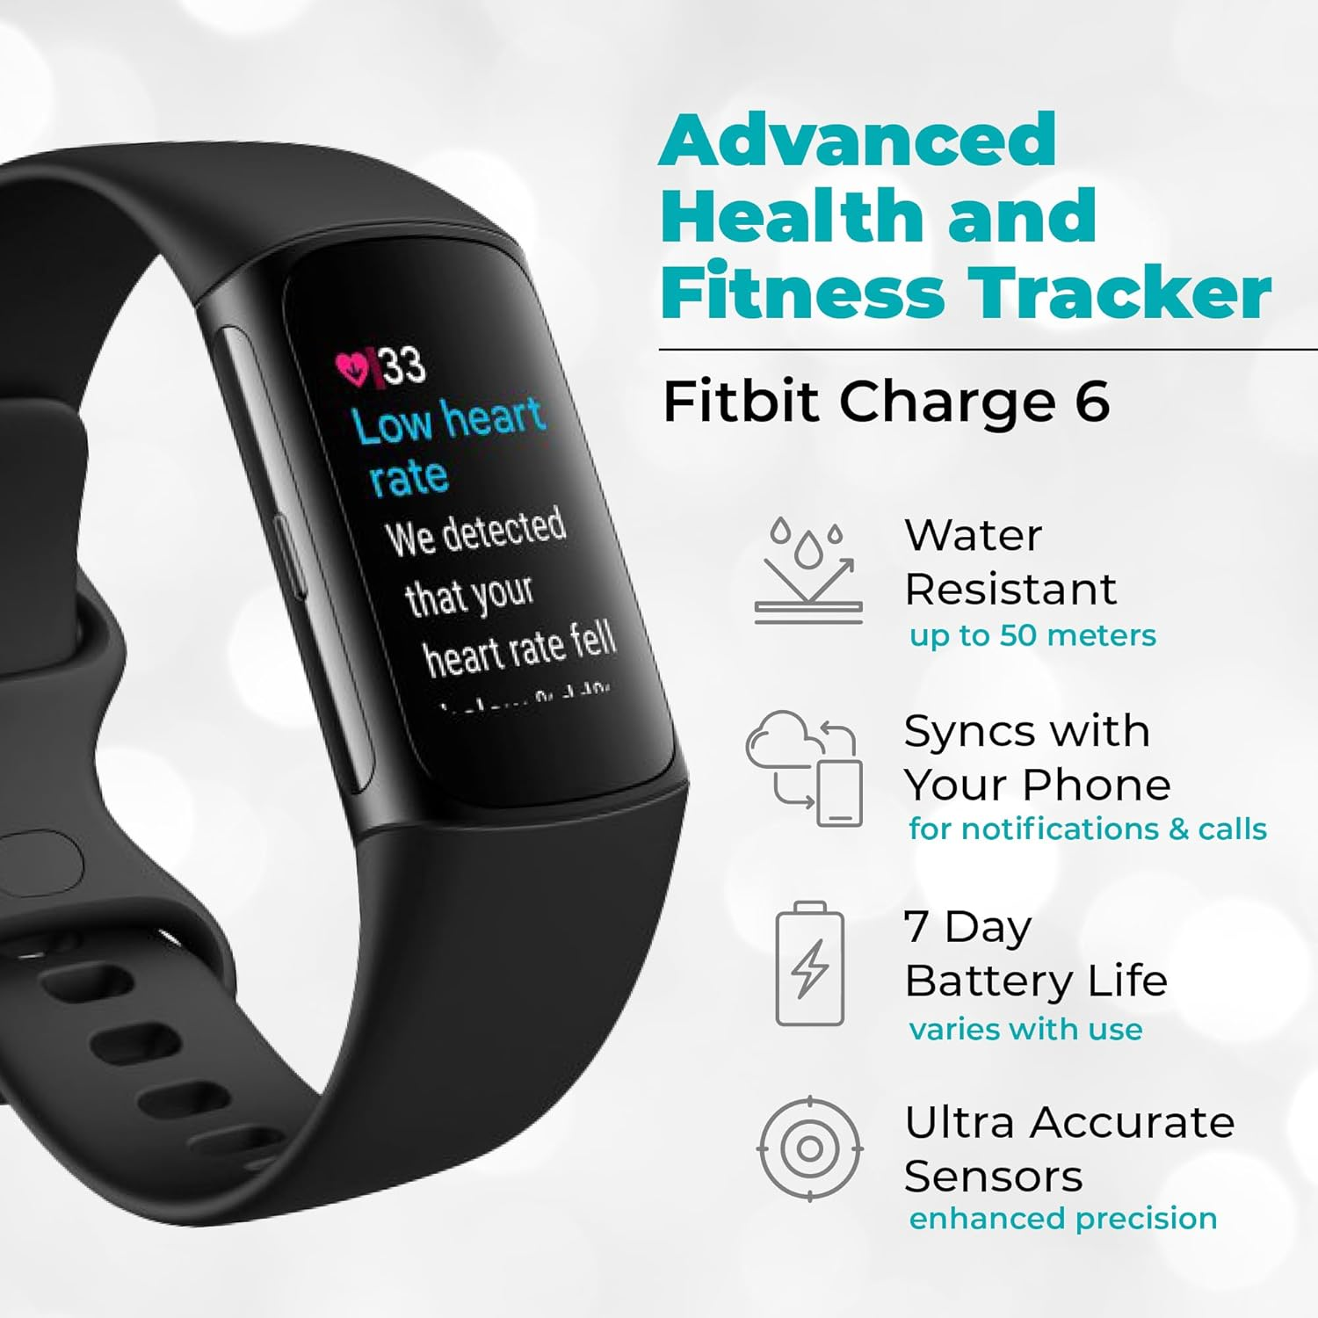
Top 5 wearables for measuring vital signs in 2025
Fitbit Charge 6
Significance:
It includes ECG functionality for heart rhythm analysis, comprehensive sleep tracking, and SpO2 monitoring. It's known for its accuracy in daily health metrics like heart rate and steps. The seamless integration with health apps and its versatility for both fitness and health monitoring make it highly regarded.
Notes:
Reasons for Selection:
Accuracy: Each of these devices has been either clinically validated or is known for high accuracy in vital sign measurements.
Versatility: They cover a range of health parameters from basic vital signs to more complex metrics like ECG or blood pressure.
User Experience: Comfort, ease of use, and minimal disruption to daily activities are considered, with options like rings for those who do not want to wear watches.
Integration: Ability to connect with mobile health apps or directly with healthcare systems for better patient management.
Innovation: Each device brings something unique to the table, whether it's through new technology implementation, form factor, or specific health monitoring capabilities.
These wearables are at the forefront of transforming personal health monitoring into actionable health insights, empowering both users and healthcare providers to manage health more effectively. However, the choice of wearable can also depend on specific health needs, lifestyle, and the medical advice of professionals.

Slide 5
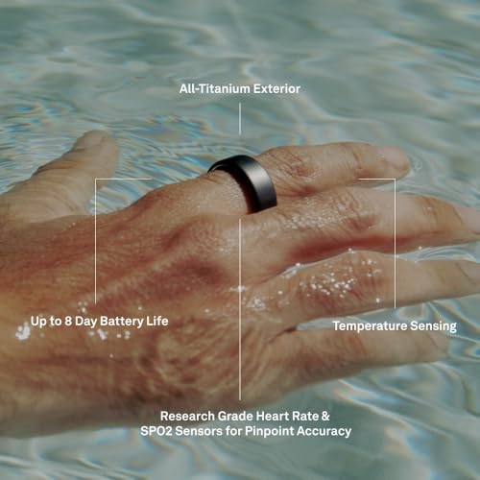
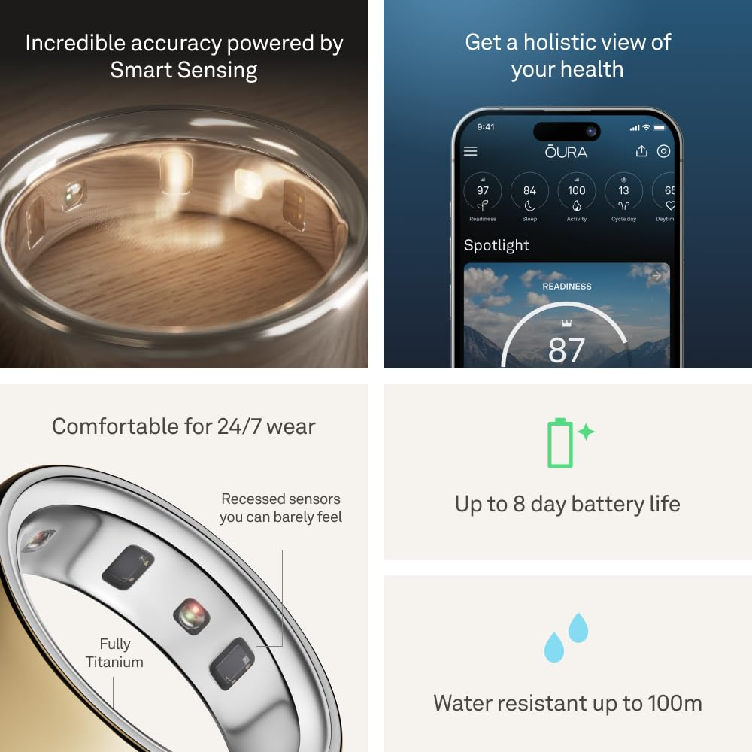
Top 5 wearables for measuring vital signs in 2025
Oura Ring 4
Significance:
This smart ring excels in providing a comprehensive health overview with minimal impact on daily activities. It monitors heart rate, SpO2, body temperature, and sleep with high precision. Its focus on a holistic health score (Vitality Score) and its sleek design make it a favorite for those who prefer not to wear larger devices.
Notes:
Reasons for Selection:
Accuracy: Each of these devices has been either clinically validated or is known for high accuracy in vital sign measurements.
Versatility: They cover a range of health parameters from basic vital signs to more complex metrics like ECG or blood pressure.
User Experience: Comfort, ease of use, and minimal disruption to daily activities are considered, with options like rings for those who do not want to wear watches.
Integration: Ability to connect with mobile health apps or directly with healthcare systems for better patient management.
Innovation: Each device brings something unique to the table, whether it's through new technology implementation, form factor, or specific health monitoring capabilities.
These wearables are at the forefront of transforming personal health monitoring into actionable health insights, empowering both users and healthcare providers to manage health more effectively. However, the choice of wearable can also depend on specific health needs, lifestyle, and the medical advice of professionals.

Slide 6
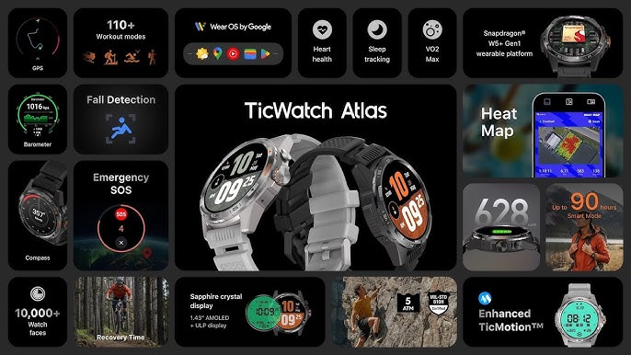
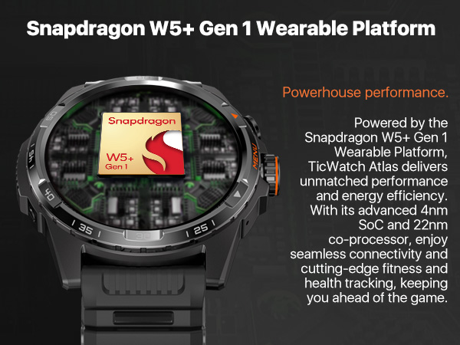
Top 5 wearables for measuring vital signs in 2025
TicWatch Atlas
Significance:
Designed for rugged use, this smartwatch offers robust health monitoring features including ECG, heart rate, and SpO2 monitoring. It's particularly noted for its durability and suitability for outdoor and extreme conditions while still providing accurate vital sign readings. Its integration with Google's Wear OS also adds to its functionality.
Notes:
Reasons for Selection:
Accuracy: Each of these devices has been either clinically validated or is known for high accuracy in vital sign measurements.
Versatility: They cover a range of health parameters from basic vital signs to more complex metrics like ECG or blood pressure.
User Experience: Comfort, ease of use, and minimal disruption to daily activities are considered, with options like rings for those who do not want to wear watches.
Integration: Ability to connect with mobile health apps or directly with healthcare systems for better patient management.
Innovation: Each device brings something unique to the table, whether it's through new technology implementation, form factor, or specific health monitoring capabilities.
These wearables are at the forefront of transforming personal health monitoring into actionable health insights, empowering both users and healthcare providers to manage health more effectively. However, the choice of wearable can also depend on specific health needs, lifestyle, and the medical advice of professionals.

Slide 7
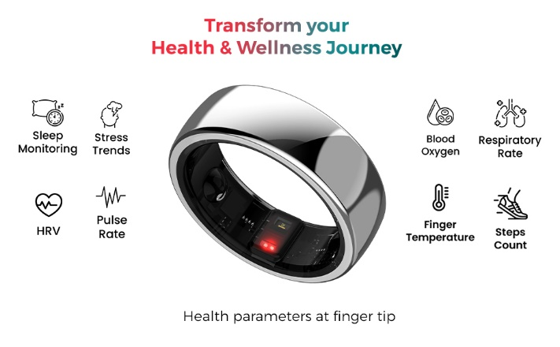
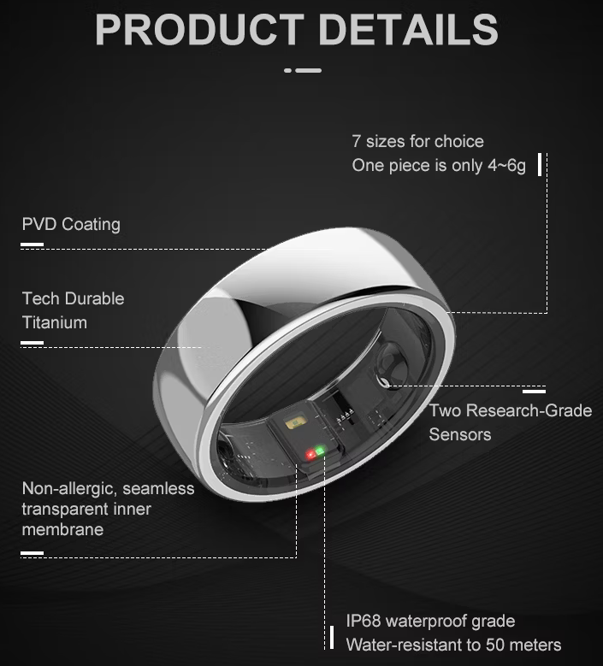
Top 5 wearables for measuring vital signs in 2025
Aabo Ring
Significance:
This ring goes beyond typical metrics by providing 24/7 monitoring of blood pressure, heart rate, and blood oxygen levels. Its innovative design and the focus on continuous vital signs make it a leader in wearable health tech for those needing constant health surveillance. However, its market penetration and full validation might still be under scrutiny.
Notes:
Reasons for Selection:
Accuracy: Each of these devices has been either clinically validated or is known for high accuracy in vital sign measurements.
Versatility: They cover a range of health parameters from basic vital signs to more complex metrics like ECG or blood pressure.
User Experience: Comfort, ease of use, and minimal disruption to daily activities are considered, with options like rings for those who do not want to wear watches.
Integration: Ability to connect with mobile health apps or directly with healthcare systems for better patient management.
Innovation: Each device brings something unique to the table, whether it's through new technology implementation, form factor, or specific health monitoring capabilities.
These wearables are at the forefront of transforming personal health monitoring into actionable health insights, empowering both users and healthcare providers to manage health more effectively. However, the choice of wearable can also depend on specific health needs, lifestyle, and the medical advice of professionals.

Slide 8
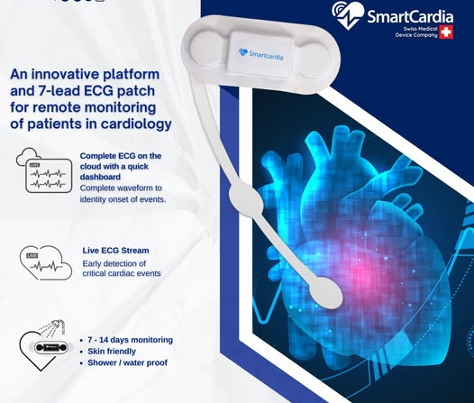
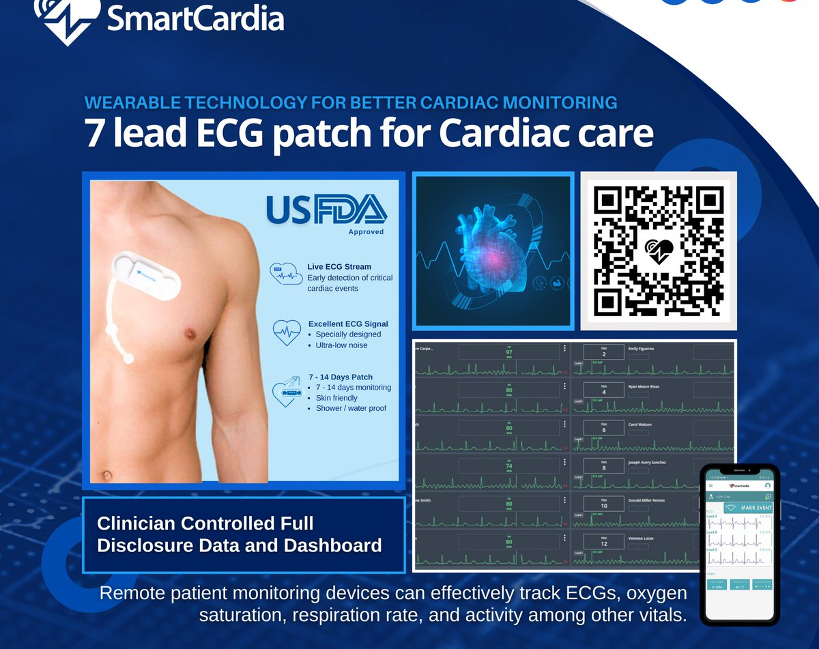
Top 5 wearables for measuring vital signs in 2025
Smartcardia 7-Lead ECG Holter Patch
Significance:
Specifically designed for medical-grade monitoring, this patch offers continuous ECG and vital sign monitoring with real-time data transmission capabilities. It's ideal for patients requiring detailed cardiac monitoring or those at risk of arrhythmias, providing live alerts for patient deterioration. Its medical focus sets it apart from more consumer-oriented devices.
Notes:
Reasons for Selection:
Accuracy: Each of these devices has been either clinically validated or is known for high accuracy in vital sign measurements.
Versatility: They cover a range of health parameters from basic vital signs to more complex metrics like ECG or blood pressure.
User Experience: Comfort, ease of use, and minimal disruption to daily activities are considered, with options like rings for those who do not want to wear watches.
Integration: Ability to connect with mobile health apps or directly with healthcare systems for better patient management.
Innovation: Each device brings something unique to the table, whether it's through new technology implementation, form factor, or specific health monitoring capabilities.
These wearables are at the forefront of transforming personal health monitoring into actionable health insights, empowering both users and healthcare providers to manage health more effectively. However, the choice of wearable can also depend on specific health needs, lifestyle, and the medical advice of professionals.

Slide 9
Using Wearables to Measure Physical Characteristics:
Heart Rate and ECG:
PPG Sensors: Found in many fitness trackers, measure heart rate by detecting blood volume changes.
ECG Sensors: More accurate for heart rhythm analysis, these might be included in specialized devices or smartwatches.
Blood Pressure:
Oscillometric Devices: Commonly used in wrist or arm monitors to measure BP.
Tonometry: Less common in wearables but found in some advanced devices for cuff-less BP monitoring.
Respiratory Rate:
Impedance Pneumography: Measures changes in thoracic impedance with each breath.
Accelerometers: Can infer respiratory rate from chest movement.
Body Temperature:
Thermistors or Thermocouples: Integrated into wearables for continuous monitoring or spot checks

Slide 10
Using Wearables to Measure Physical Characteristics:
Glucose Monitoring:
Continuous Glucose Monitors (CGMs): Use subcutaneous sensors to provide real-time glucose levels.
Electrolytes and Other Blood Parameters:
Non-invasive methods are less common, but research is ongoing. Wearables might measure sweat or use spectroscopy for some ions.
Physical Activity:
Accelerometers and Gyroscopes: Track movement, steps, and physical activity intensity.
Sleep Monitoring:
Combines movement sensors with possibly heart rate variability or even EEG to assess sleep stages.
Body Composition:
Bioelectrical Impedance Analysis (BIA): Sends a small electrical current through the body to estimate fat, muscle, and hydration levels

Slide 11
Biochemical parameters measured by Biosensors
Definition: Biochemical components in the body refer to various substances that can be measured to assess health status, diagnose diseases, or monitor treatment efficacy. Here are some key measurable biochemical components: Glucose levels (enzymatic electrochemical sensors), sweat electrolytes (ion-selective electrodes), oxygen saturation (optical sensors).
Highlights:
Provide direct insights into metabolic processes and physiological status.
Crucial for managing chronic conditions like diabetes and electrolyte imbalances.
Challenges include sensor stability, biocompatibility, and calibration.
Measurable Biochemical Components:
Glucose:
Cholesterol and Lipids:
Electrolytes (Sodium, Potassium, Chloride, etc.):
Urea and Creatinine:
Notes:
Biochemical components in the body refer to various substances that can be measured to assess health status, diagnose diseases, or monitor treatment efficacy. Here are some key measurable biochemical components and methods used to measure them:
Measurable Biochemical Components:
Glucose:
Importance: Essential for diagnosing and managing diabetes.
Measurement:
Blood Glucose Meters: Use a small drop of blood from a fingerstick to measure glucose levels through an enzymatic reaction that produces an electrical signal proportional to glucose concentration.
Continuous Glucose Monitors (CGMs): Use a subcutaneous sensor to measure interstitial fluid glucose levels continuously, providing real-time data.
Cholesterol and Lipids:
Importance: Critical for assessing cardiovascular risk.
Measurement:
Blood Tests: Usually involves a lipid panel where blood is drawn and analyzed in a lab for total cholesterol, HDL, LDL, and triglycerides using methods like enzymatic colorimetric assays.
Electrolytes (Sodium, Potassium, Chloride, etc.):
Importance: Balance is key for nerve and muscle function, hydration, and acid-base balance.
Measurement:
Blood or Serum Testing: Ion-selective electrodes measure the concentration of electrolytes in blood or serum.
Emerging Wearable Tech: Research into non-invasive methods like sweat analysis for real-time monitoring.
Urea and Creatinine:
Importance: Indicators of kidney function.
Measurement:
Blood Tests: Measured via enzymatic reactions in blood samples.
Urine Tests: Creatinine can also be measured in urine to assess kidney filtration rate.
Liver Enzymes (ALT, AST, ALP, GGT):
Importance: Help diagnose liver damage or disease.
Measurement:
Blood Tests: These enzymes are measured through enzymatic assays where the enzyme catalyzes a reaction producing a measurable color change.
Hormones (e.g., Thyroid Hormones, Insulin, Cortisol):
Importance: Regulate various bodily functions including metabolism, growth, and stress response.
Measurement:
Immunoassays: Techniques like ELISA (Enzyme-Linked Immunosorbent Assay) use antibodies to detect hormone levels in blood.
Mass Spectrometry: For more precise measurement in some clinical or research settings.
Lactate:
Importance: Indicates muscle fatigue, oxygen debt, and can be elevated in sepsis or shock.
Measurement:
Blood Tests: Using enzymatic reactions that convert lactate to pyruvate, producing a color change or electrical signal.
Wearable Sensors: Some advanced wearables for athletes measure lactate non-invasively through sweat.
pH:
Importance: Reflects acid-base status, crucial in critical care scenarios.
Measurement:
Blood Gas Analysis: Direct measurement using sensors in blood gas analyzers.
Wearable Patches: Experimental devices for monitoring through skin or sweat pH.

Slide 12
Biochemical parameters measured by Biosensors
Measurable Biochemical Components:
Liver Enzymes (ALT, AST, ALP, GGT):
Hormones (e.g., Thyroid Hormones, Insulin, Cortisol):
Lactate:
pH
How They are Measured:
Invasive Methods: Most biochemical components are traditionally measured through blood draws or urine collection, where samples are then analyzed in labs using techniques like spectrometry, immunoassays, or electrophoresis.
Non-Invasive Methods:
Sweat Sensors: Wearable patches or devices that analyze sweat for biochemical markers like electrolytes or glucose.
Breath Analysis: For detecting volatile organic compounds or gases like acetone for diabetes management.
Optical Sensors: Some biochemicals can be measured through the skin using light (e.g., pulse oximetry for oxygen saturation).
Point-of-Care Testing (POCT): Portable devices that provide quick results at the patient's side, often using a smaller sample size than traditional lab tests.
Continuous Monitoring: Developments in wearable technology are moving towards real-time, continuous monitoring of some biochemical markers, especially glucose, through minimally invasive or non-invasive methods.
Notes:
Biochemical components in the body refer to various substances that can be measured to assess health status, diagnose diseases, or monitor treatment efficacy. Here are some key measurable biochemical components and methods used to measure them:
Measurable Biochemical Components:
Glucose:
Importance: Essential for diagnosing and managing diabetes.
Measurement:
Blood Glucose Meters: Use a small drop of blood from a fingerstick to measure glucose levels through an enzymatic reaction that produces an electrical signal proportional to glucose concentration.
Continuous Glucose Monitors (CGMs): Use a subcutaneous sensor to measure interstitial fluid glucose levels continuously, providing real-time data.
Cholesterol and Lipids:
Importance: Critical for assessing cardiovascular risk.
Measurement:
Blood Tests: Usually involves a lipid panel where blood is drawn and analyzed in a lab for total cholesterol, HDL, LDL, and triglycerides using methods like enzymatic colorimetric assays.
Electrolytes (Sodium, Potassium, Chloride, etc.):
Importance: Balance is key for nerve and muscle function, hydration, and acid-base balance.
Measurement:
Blood or Serum Testing: Ion-selective electrodes measure the concentration of electrolytes in blood or serum.
Emerging Wearable Tech: Research into non-invasive methods like sweat analysis for real-time monitoring.
Urea and Creatinine:
Importance: Indicators of kidney function.
Measurement:
Blood Tests: Measured via enzymatic reactions in blood samples.
Urine Tests: Creatinine can also be measured in urine to assess kidney filtration rate.
Liver Enzymes (ALT, AST, ALP, GGT):
Importance: Help diagnose liver damage or disease.
Measurement:
Blood Tests: These enzymes are measured through enzymatic assays where the enzyme catalyzes a reaction producing a measurable color change.
Hormones (e.g., Thyroid Hormones, Insulin, Cortisol):
Importance: Regulate various bodily functions including metabolism, growth, and stress response.
Measurement:
Immunoassays: Techniques like ELISA (Enzyme-Linked Immunosorbent Assay) use antibodies to detect hormone levels in blood.
Mass Spectrometry: For more precise measurement in some clinical or research settings.
Lactate:
Importance: Indicates muscle fatigue, oxygen debt, and can be elevated in sepsis or shock.
Measurement:
Blood Tests: Using enzymatic reactions that convert lactate to pyruvate, producing a color change or electrical signal.
Wearable Sensors: Some advanced wearables for athletes measure lactate non-invasively through sweat.
pH:
Importance: Reflects acid-base status, crucial in critical care scenarios.
Measurement:
Blood Gas Analysis: Direct measurement using sensors in blood gas analyzers.
Wearable Patches: Experimental devices for monitoring through skin or sweat pH.

Slide 13
the types of Biosensors
Wearable sensors can be categorized based on their level of invasiveness, which pertains to how they interact with the body to collect data.
1. Non-Invasive Sensors
These sensors do not penetrate the skin or require any bodily fluids for operation. They are designed to be as unobtrusive as possible, focusing on external or surface-level data collection. Examples:
Optical Sensors (PPG):
Temperature Sensors:
Accelerometers/Gyroscopes:
Electrodes for Bioimpedance:
Advantages:
Comfortable for long-term wear.
No risk of infection or discomfort associated with skin penetration.
Suitable for continuous monitoring without medical intervention.
Limitations:
Might be less accurate for deep physiological metrics compared to invasive methods.
Affected by external factors like skin pigmentation, ambient light, or movement.
Notes:
Wearable sensors can be categorized based on their level of invasiveness, which pertains to how they interact with the body to collect data. Here's an explanation of these types:
1. Non-Invasive Sensors
These sensors do not penetrate the skin or require any bodily fluids for operation. They are designed to be as unobtrusive as possible, focusing on external or surface-level data collection.
Examples:
Optical Sensors (PPG): Used for heart rate, SpO2 measurement by shining light through the skin to detect blood flow changes.
Temperature Sensors: Measure skin temperature to infer core body temperature.
Accelerometers/Gyroscopes: Monitor movement, posture, or activity levels.
Electrodes for Bioimpedance: Assess body composition or hydration by sending a small electrical current through the body.
Advantages:
Comfortable for long-term wear.
No risk of infection or discomfort associated with skin penetration.
Suitable for continuous monitoring without medical intervention.
Limitations:
Might be less accurate for deep physiological metrics compared to invasive methods.
Affected by external factors like skin pigmentation, ambient light, or movement.

Slide 14
the types of Biosensors
2. Minimally Invasive Sensors
These sensors involve a slight breach of the skin barrier but are still considered safe for long-term use with little to no discomfort.
Examples:
Continuous Glucose Monitors (CGMs):
Microneedle Sensors:
Advantages:
Provide more accurate data than non-invasive methods for certain metrics like glucose levels.
Real-time data collection with less frequent calibration than traditional methods.
Limitations:
Potential for minor skin irritation or infection at the insertion site.
Need for periodic sensor replacement or calibration.
Notes:
2. Minimally Invasive Sensors
These sensors involve a slight breach of the skin barrier but are still considered safe for long-term use with little to no discomfort.
Examples:
Continuous Glucose Monitors (CGMs): A small filament is inserted under the skin to measure glucose in interstitial fluid.
Microneedle Sensors: Use an array of tiny needles to sample interstitial fluid for biochemical markers.
Advantages:
Provide more accurate data than non-invasive methods for certain metrics like glucose levels.
Real-time data collection with less frequent calibration than traditional methods.
Limitations:
Potential for minor skin irritation or infection at the insertion site.
Need for periodic sensor replacement or calibration.
3. Invasive Sensors
These sensors require a more substantial intervention, often involving blood sampling or deeper tissue penetration, which is generally used for medical diagnostics rather than continuous monitoring.
Examples:
Implantable Sensors: For long-term monitoring of conditions like epilepsy or heart rhythm disorders, where a device is surgically placed inside the body.
Catheter-Based Sensors: Used in intensive care settings for real-time measurement of blood pressure, blood gases, or other critical parameters.
Advantages:
Highly accurate for in-depth physiological monitoring.
Can provide real-time data for critical care scenarios.
Limitations:
Risk of infection, rejection, or complications related to surgical implantation.
Not suitable for consumer use due to the need for medical intervention for placement and removal.
Often requires professional healthcare management.

Slide 15
the types of Biosensors
3. Invasive Sensors
These sensors require a more substantial intervention, often involving blood sampling or deeper tissue penetration, which is generally used for medical diagnostics rather than continuous monitoring. Examples:
Implantable Sensors: For long-term monitoring of conditions like epilepsy or heart rhythm disorders, where a device is surgically placed inside the body.
Catheter-Based Sensors: Used in intensive care settings for real-time measurement of blood pressure, blood gases, or other critical parameters.
Advantages:
Highly accurate for in-depth physiological monitoring.
Can provide real-time data for critical care scenarios.
Limitations:
Risk of infection, rejection, or complications related to surgical implantation.
Not suitable for consumer use due to the need for medical intervention for placement and removal.
Often requires professional healthcare management.
Notes:
3. Invasive Sensors
These sensors require a more substantial intervention, often involving blood sampling or deeper tissue penetration, which is generally used for medical diagnostics rather than continuous monitoring.
Examples:
Implantable Sensors: For long-term monitoring of conditions like epilepsy or heart rhythm disorders, where a device is surgically placed inside the body.
Catheter-Based Sensors: Used in intensive care settings for real-time measurement of blood pressure, blood gases, or other critical parameters.
Advantages:
Highly accurate for in-depth physiological monitoring.
Can provide real-time data for critical care scenarios.
Limitations:
Risk of infection, rejection, or complications related to surgical implantation.
Not suitable for consumer use due to the need for medical intervention for placement and removal.
Often requires professional healthcare management.

Slide 16
Working Principles of Wearable Sensors:
Electrical Sensing:
Principle: Measures changes in electrical properties like resistance, capacitance, or voltage.
Examples: Electrocardiogram (ECG) for heart activity
Optical Sensing:
Principle: Uses light (often in the form of LEDs and photodetectors) to measure changes in how light is absorbed, reflected, or transmitted through tissues or fluids.
Examples: oxygen saturation for pulse oximetry.
Mechanical Sensing:
Principle: Detects physical motion, pressure, or deformation.
Examples: gyroscopes for orientation, piezoelectric sensors for pressure.
Thermal Sensing:
Principle: Measures temperature changes or heat flow.
Examples: Thermistors for body temperature,
Chemical Sensing:
Principle: Detects chemical changes or concentrations in biological fluids or the environment.
Examples: sweat sensors for electrolyte or glucose detection.
Notes:
Wearable sensors, including both normal sensors and biosensors, leverage a variety of physical and biochemical principles to measure and interpret data from the human body. Here, I'll explain the working principles of wearable sensors in general, then delve into the differences between normal sensors and biosensors.
Working Principles of Wearable Sensors:
Electrical Sensing:
Principle: Measures changes in electrical properties like resistance, capacitance, or voltage.
Examples: Electrocardiogram (ECG) for heart activity, Electromyography (EMG) for muscle activity.
Optical Sensing:
Principle: Uses light (often in the form of LEDs and photodetectors) to measure changes in how light is absorbed, reflected, or transmitted through tissues or fluids.
Examples: Photoplethysmography (PPG) for heart rate and oxygen saturation, pulse oximetry.
Mechanical Sensing:
Principle: Detects physical motion, pressure, or deformation.
Examples: Accelerometers for motion, gyroscopes for orientation, piezoelectric sensors for pressure.
Thermal Sensing:
Principle: Measures temperature changes or heat flow.
Examples: Thermistors for body temperature, infrared sensors for skin temperature.
Chemical Sensing:
Principle: Detects chemical changes or concentrations in biological fluids or the environment.
Examples: Gas sensors for breath analysis, sweat sensors for electrolyte or glucose detection.

Slide 17
Differences between Normal Sensors and Biosensors:
Normal Sensors: Working Principle:
Direct Measurement: They typically measure physical changes directly. For instance, an accelerometer measures acceleration due to motion, or a temperature sensor measures heat.
Indirect Physiological Inference: The data collected can be used to infer physiological states (e.g., activity level from motion), but the sensor itself isn't designed to interact with biological substances.
Examples:
Accelerometer: Measures movement for activity tracking.
Gyroscope: Detects orientation for balance or gesture recognition.
Barometer: Measures atmospheric pressure for altitude or weather changes.
Biosensors: Working Principle:
Bio recognition: The sensor has a biological element that recognizes and binds to a specific target molecule or group of molecules. This binding event triggers a measurable change.
Transduction: The biological event is converted into an electronic signal through various methods like electrochemical, optical, or piezoelectric transduction.
Specificity: Biosensors are designed to be highly specific to particular analytes (e.g., glucose, lactate, specific pathogens).
Examples:
Glucose Sensors: Use enzymes like glucose oxidase to catalyze a reaction that produces a measurable electrical signal proportional to glucose concentration.
Wearable Patch for Lactate: Detects lactate in sweat using specific enzymes or antibodies.
Antibody-Based Sensors: For detecting specific proteins or pathogens in sweat or other fluids.
Key Differences:
Interaction with Biology
Specificity and Sensitivity
Calibration and Maintenance
Applications:
Notes:
Key Differences:
Interaction with Biology: Biosensors directly interact with biological substances or processes, whereas normal sensors might only measure physical parameters indirectly related to health.
Complexity: Biosensors often have more complex designs due to the need for biological recognition elements and sometimes additional layers for signal amplification or stabilization.
Specificity and Sensitivity: Biosensors are tailored for high specificity to target molecules, allowing for precise health diagnostics or monitoring, while normal sensors are generally broader in their application but might lack the same level of molecular detail.
Calibration and Maintenance: Biosensors might require more careful calibration and can be more susceptible to degradation of the biological components over time, necessitating replacement or recalibration.
Application: Normal sensors are widely used in fitness tracking and general health monitoring, while biosensors are crucial in medical diagnostics, personalized medicine, and for continuous monitoring of specific health conditions. Understanding these principles helps in selecting the right type of sensor for specific applications in wearable technology, whether for general health insights or targeted medical monitoring.

Slide 18
Characteristics of Wearable Sensors:
Metrics:
Sensitivity:
Specificity
Accuracy
Precision
Response Time
Stability
Key points:
Application Suitability:
Design and Calibration:
Calibration:
Influence on Performance:
Notes:
Definition & Metrics:
Sensitivity:
Definition: The ratio of change in sensor output to the change in the measured input.
Example: For a glucose sensor, sensitivity would be how much the sensor's electrical output changes for each millimole per liter increase in glucose concentration.
Specificity:
Definition: The ability of the sensor to respond exclusively to the target analyte in the presence of other substances.
Example: An oxygen sensor must detect O2 without interference from CO2 or other gases present in exhaled breath.
Accuracy:
Definition: How close the sensor's output is to the true value of the measured parameter.
Example: An accurate heart rate monitor would give readings that closely match those from a clinical-grade ECG.
Precision:
Definition: The degree of consistency or reproducibility of measurements when taken under identical conditions.
Example: A pedometer that counts steps with minimal variation from test to test.
Response Time:
Definition: The duration from when the sensor detects a change in input to when it reflects this change in its output.
Example: The time it takes for a blood pressure sensor to stabilize after cuff inflation.
Stability:
Definition: The ability of the sensor to maintain performance characteristics over time under specified conditions.
Example: A temperature sensor should provide consistent readings over months without drift.
Highlights:
Application Suitability: These metrics collectively dictate whether a sensor is appropriate for its intended use. Sensitivity and specificity are crucial for diagnostic applications where precise detection of specific analytes is necessary.
Design and Calibration:
Design: Sensor design must optimize for these metrics, potentially involving trade-offs (e.g., high sensitivity might reduce stability).
Calibration: Regular calibration is essential to maintain accuracy and precision, with protocols often tailored to ensure sensors meet the required performance over their operational life.
Influence on Performance:
Each characteristic impacts not only the raw data collected but also how this data is interpreted in clinical or health management contexts.
Stability and response time are particularly important for continuous monitoring applications, ensuring reliable long-term data collection.
Conclusion:
Understanding and optimizing these performance metrics are fundamental to developing wearable sensors that can deliver reliable, actionable health data. They guide the engineering process from sensor selection to deployment in real-world scenarios.

Slide 19
Fabrication of Wearable Sensors Using Electrical Properties: Utilizing Electrical Changes for Sensing
Wearable sensors that leverage electrical properties for sensing are based on detecting variations in electrical characteristics of the body or its immediate environment.
1 Impedance Sensors:
Impedance sensors measure the opposition to alternating current (AC) flow in biological tissues or fluids. This opposition, known as impedance, varies with frequency and is influenced by the composition, hydration, and cellular structure of the material being measured.
Highlights:
Non-Invasive: These sensors can be integrated into wearable devices like wristbands or patches, making them ideal for continuous monitoring without patient discomfort.
Physiological Insights: They provide indirect information about physiological states, including tissue health, hydration status, or even detecting certain diseases by changes in tissue impedance.

Slide 20
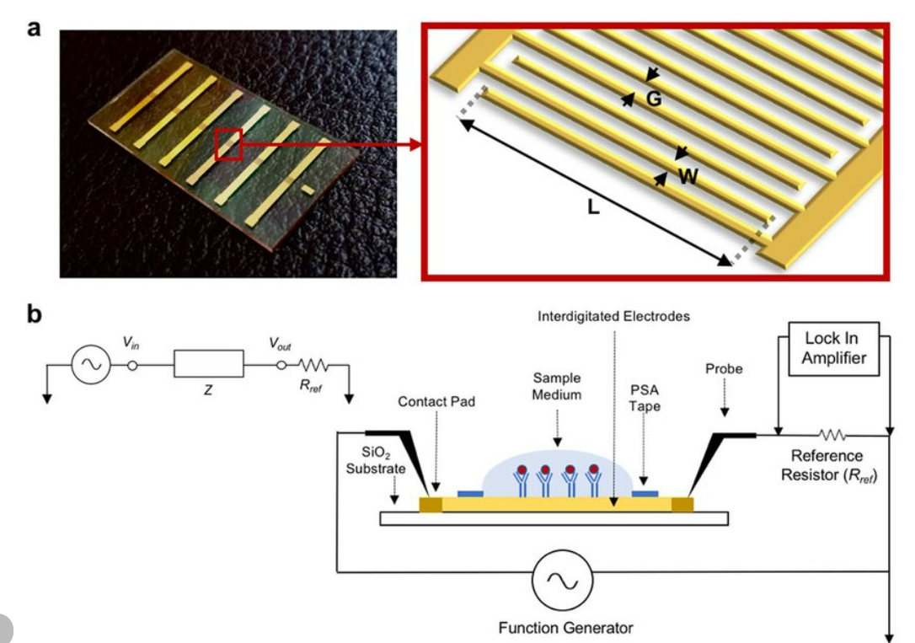
Fabrication of Wearable Sensors Using Electrical Properties: Utilizing Electrical Changes for Sensing
2 Design of an Optimum IDE Electrode Configuration: Interdigitated Electrodes (IDE) are used in sensors where the electrode pattern consists of alternating fingers of two conductive materials. The design includes optimizing the spacing between electrodes (pitch), the width of the fingers, and the number of finger pairs.
Highlights:
Sensitivity Optimization: By varying the geometry of the IDE, one can achieve higher sensitivity to changes in the material's electrical properties between the electrodes.
Noise Reduction: Proper design minimizes unwanted capacitance or resistance that could introduce noise, ensuring clearer signal detection.
Simulation and Optimization:
Finite Element Analysis (FEA): This computational method is used to simulate how different IDE configurations would perform under various conditions. FEA helps in understanding electric field distribution, optimizing for the target analyte's detection, and ensuring the design provides the best signal-to-noise ratio.
Source: https://shorturl.at/btyd7
Sensor preparation and platform development. (a) Fabricated IDE sensor array and schematic of the IDE sensing area geometry. L=length, W=width, and G=gap of the working electrode. The IDE sensor is composed of interdigitated electrodes with adjoining electrode contact pads, and borosilicate glass substrate. Probe electrodes were placed on the contact pads to deliver excitation current to, and to measure electrical signals from, the sensors.

Slide 21
Fabrication of Wearable Sensors Using Electrical Properties: Utilizing Electrical Changes for Sensing
3 Perfect Capacitive IDE Sensors: In a perfect capacitive IDE sensor model, the capacitance between the electrodes is considered solely due to the dielectric properties of the material placed between them, without considering real-world imperfections like parasitic capacitances or resistances.
Highlights:
Theoretical Model: This idealized model helps in understanding the fundamental behavior of capacitive sensors in terms of sensitivity to changes in dielectric constants, which can be affected by material composition, temperature, or the presence of specific analytes.
Capacitance Relationship: The capacitance (C) of an IDE depends on the permittivity (ε) of the material, the area (A) of the electrode overlap, and the distance (d) between the electrodes (C = ε * A / d).
Dielectric Properties: Changes in the dielectric properties of the medium (like skin or sweat) due to physiological changes can be detected as variations in capacitance.
Notes:
These approaches in sensor fabrication and design are crucial for advancing wearable technology, where the goal is to create devices that are not only accurate and sensitive but also comfortable and practical for everyday use. Each method has its unique challenges and advantages, tailored to different health monitoring applications.
Impedance sensor applications

Slide 22
Piezoelectric wearable sensors.
Sensors that generate an electrical charge in response to mechanical stress or strain. Example: Motion sensors, pressure sensors, force sensors.
Highlights:
Self-powered and can be used for energy harvesting.
Sensitive to temperature and humidity.
Design Considerations:
Material Selection: The choice of piezoelectric material (like PVDF, PZT, or newer composites) affects sensitivity, durability, and compatibility with the body or clothing materials.
Applications:
Health Monitoring: They can be used for monitoring heartbeats, respiratory rate
Interaction: Piezoelectric sensors can enable new forms of user interaction with technology, like touch-sensitive fabrics or responsive clothing.
Challenges:
Calibration: Due to environmental sensitivity, calibration might be more complex or frequent to ensure consistent performance.
Notes:
1.8 Piezoelectric Wearable Sensors:
Definition: Piezoelectric wearable sensors are devices that utilize the piezoelectric effect, where certain materials generate an electric charge in response to applied mechanical stress or strain. This effect is reversible; the materials can also change dimensions when an external electric field is applied, which is known as the inverse piezoelectric effect.
Example:
Motion Sensors: These can detect movements like walking, running, or even subtle gestures by converting the physical motion into electrical signals. Piezoelectric materials in shoe insoles, for example, can measure gait or steps.
Pressure Sensors: Used in applications where pressure changes need monitoring, such as in smart clothing for posture correction or in seating for detecting when someone sits down.
Force Sensors: These can be integrated into devices for measuring the force applied during activities like gripping, pushing, or squeezing, which can be useful in sports equipment or rehabilitation devices.
Highlights:
Self-Powered: One of the most significant advantages is that piezoelectric sensors can generate their own power from the mechanical energy they detect. This self-sustaining nature can lead to energy harvesting, where the energy from body movements is converted into electrical energy, potentially powering other wearable components or charging small batteries.
Energy Harvesting: The ability to convert ambient mechanical energy into electrical energy makes these sensors particularly useful in scenarios where replacing or recharging batteries is inconvenient or impractical. For instance, they can harvest energy from footsteps or heartbeat vibrations.
Sensitivity to Environmental Factors:
Temperature: The piezoelectric properties can change with temperature, affecting sensor performance. Calibration or compensation strategies might be necessary for accurate readings across a range of temperatures.
Humidity: High humidity can also affect the performance of piezoelectric materials, especially if not properly encapsulated or if the material is sensitive to moisture. This might lead to signal drift or reduced sensitivity.
Design Considerations:
Material Selection: The choice of piezoelectric material (like PVDF, PZT, or newer composites) affects sensitivity, durability, and compatibility with the body or clothing materials.
Integration: Embedding these sensors into wearables requires careful consideration of flexibility, comfort, and the mechanical integrity of the device, ensuring it can withstand daily wear and tear.
Applications:
Health Monitoring: They can be used for monitoring heartbeats, respiratory rate, or even muscle activity through the detection of micro-vibrations or pressure changes.
Interaction: Piezoelectric sensors can enable new forms of user interaction with technology, like touch-sensitive fabrics or responsive clothing.
Challenges:
Calibration: Due to environmental sensitivity, calibration might be more complex or frequent to ensure consistent performance.
Signal Processing: The raw electrical signals from piezoelectric sensors often require sophisticated processing to filter out noise and accurately interpret the mechanical changes.
Piezoelectric sensors in wearables represent an innovative approach to sensing and power generation, combining functionality with the potential for energy efficiency. However, their integration into everyday wearables must address challenges related to environmental impacts and user comfort to fully realize their benefits.
REAL USE CASES OF WEARABLES: Health monitoring (heart rate, ECG, SpO2, glucose), fitness tracking (activity level, sleep quality), sports performance monitoring (biomechanics, training load), medical diagnostics (remote patient monitoring, early disease detection), and industrial safety (monitoring worker health and environmental conditions).

Slide 23
Wearable flexible sensors: fabrication and characterization
1 Flexible sensors and their advantages. - Sensors built on flexible substrates, allowing them to conform to the body's contours. Example: Flexible strain gauges for motion capture, flexible pressure sensors for tactile sensing.
Highlights: - Conformability and comfort: Enables long-term wearability & minimizes discomfort. - Integration with textiles and wearables: Allows for seamless integration into clothing and accessories. - Applications in healthcare, sports, and human-machine interfaces.
Flexible sensors represent a frontier in wearable technology, offering a blend of functionality, comfort
Notes:
2.1 Introduction: Overview of Flexible Sensors and Their Advantages
Definition:
Flexible Sensors: These are sensors constructed on substrates that can bend, stretch, or twist without significant loss of functionality. They are made from materials that retain their sensing properties under mechanical deformation. Examples include:
Flexible strain gauges: Made from materials like conductive polymers or graphene, these can be applied to areas where movement is monitored, such as joints or muscles, to capture motion data continuously.
Flexible pressure sensors: Often composed of layers of conductive and dielectric materials, used in applications like touch-sensitive fabrics or for measuring pressure distribution in shoes or seating.
Technical Facts on Construction and Materials:
Substrates: Common flexible substrates include polyimide (PI), polyethylene terephthalate (PET), poly(dimethylsiloxane) (PDMS), and more recently, eco-friendly materials like cellulose nanofibers. These substrates allow for the sensors to be thin, lightweight, and capable of significant bending or stretching.
Conductive Materials: Conductive inks based on silver, carbon nanotubes, or graphene are screen-printed or deposited onto these substrates to form the sensor elements. These materials maintain conductivity even when stretched.
Encapsulation: To protect the sensors from environmental conditions like moisture, sweat, or mechanical wear, they are often encapsulated with flexible, biocompatible, and sometimes breathable materials.
Advantages:
Conformability and Comfort:
Mechanical Properties: The flexibility allows these sensors to conform to the body's contours, reducing the mechanical mismatch between the sensor and skin, which can lead to better data accuracy due to improved contact and less movement artifact.
Comfort: Being lightweight and adaptable, flexible sensors do not restrict movement, making them ideal for long-term wear, which is crucial for continuous health monitoring or rehabilitation.
Integration with Textiles and Wearables:
Manufacturing Techniques: Techniques like screen printing, inkjet printing, or even weaving conductive threads into fabrics allow for the integration of sensors directly into clothing or accessories, enhancing functionality without compromising aesthetics or comfort.
Seamless Design: This integration can be at a micro-scale, making the sensors nearly invisible or non-intrusive, which is key for consumer acceptance and widespread use.
Applications and Technical Highlights:
Healthcare:
Monitoring: Flexible sensors can monitor vital signs like heart rate, respiration, and even blood pressure non-invasively over extended periods due to their comfort and conformability.
Rehabilitation: Used in smart garments to track movement patterns, aiding in physical therapy by providing feedback on posture or gait.
Sports:
Performance Analysis: They can measure muscle activity, joint angles, or forces exerted during sports activities, providing real-time feedback for performance optimization or injury prevention.
Biomechanics: Flexible sensors help in studying the biomechanics of athletes by fitting into sports gear or clothing, capturing data in natural movement contexts.
Human-Machine Interfaces (HMI):
Gesture Recognition: Wearable flexible sensors can interpret gestures or even subtle skin deformations into control signals for devices, enhancing interaction in virtual or augmented reality settings.
Haptic Feedback: Incorporating flexible pressure sensors into gloves or other wearables for providing tactile feedback in applications like robotics or gaming.
Challenges and Considerations:
Durability: While flexible, these sensors must still endure repeated bending, stretching, and exposure to environmental factors, necessitating robust design and material choices.
Signal Integrity: Maintaining signal quality under deformation requires advanced materials or circuit designs to minimize noise or drift.
Cost and Scalability: The cost of flexible electronics can be higher due to specialized materials or processes, although ongoing research aims at reducing these through scalable manufacturing techniques.
Flexible sensors represent a frontier in wearable technology, offering a blend of functionality, comfort, and integration that traditional rigid sensors cannot match, pushing forward both research and commercial applications in various fields.

Slide 24
Fabrication of flexible sensors: Manufacturing processes for flexible sensors.
2.2.1 Materials used for fabrication: Conductive polymers (e.g., PEDOT:PSS), nanomaterials (e.g., carbon nanotubes, graphene), flexible substrates (e.g., PET, PDMS, Kapton). - Highlights: Material selection is crucial for sensor performance, flexibility, biocompatibility, and durability.
The fabrication of flexible sensors involves not only choosing the right materials but also optimizing manufacturing processes to ensure the sensors are both functional and practical in their application context. This includes considerations for scalability, cost, and the environmental impact of production methods.
Notes:
2 Fabrication of Flexible Sensors: Manufacturing Processes for Flexible Sensors
2.2.1 Materials Used for Fabrication:
The choice of materials in the fabrication of flexible sensors directly influences their functionality, flexibility, durability, and biocompatibility. Here's a detailed look at the commonly used materials:
Conductive Polymers:
PEDOT:PSS (Poly(3,4-ethylenedioxythiophene) polystyrene sulfonate):
Properties: PEDOT:PSS is highly conductive, transparent, and can be processed from aqueous solutions, which makes it suitable for flexible electronics. It's known for its stability, resistance to oxidation, and flexibility.
Applications: Used in strain, pressure, and temperature sensors due to its ability to change conductivity under mechanical deformation. Its biocompatibility makes it ideal for biomedical applications.
Nanomaterials:
Carbon Nanotubes (CNTs):
Properties: CNTs offer exceptional mechanical strength, electrical conductivity, and flexibility. They can be single-walled or multi-walled, impacting their electrical and mechanical properties.
Advantages: When incorporated into sensors, CNTs enhance sensitivity due to their high surface area and can be used to make very flexible and stretchable conductive networks.
Challenges: Dispersion in polymers or inks for uniform application can be challenging; however, functionalization can improve this.
Graphene:
Properties: Graphene is a one-atom-thick layer of carbon with remarkable electrical conductivity, flexibility, and strength. It has a high surface-to-volume ratio, which is beneficial for sensing applications.
Applications: Graphene can be used in flexible strain sensors, where changes in resistance correlate with strain. Its transparency and conductivity also make it appealing for optical sensors.
Flexible Substrates:
PET (Polyethylene Terephthalate):
Properties: PET is widely used due to its low cost, high transparency, and good tensile strength. It provides a balance between flexibility and durability but is less suitable for high-temperature processes.
Use: Common in applications where optical transparency is required, like in touch sensors or displays.
PDMS (Polydimethylsiloxane):
Properties: PDMS is known for its excellent flexibility, biocompatibility, and optical transparency. It can be easily molded into complex shapes and has good gas permeability.
Advantages: Its elastomeric nature makes it ideal for stretchable electronics, particularly in sensors needing to conform to biological surfaces.
Kapton (Polyimide):
Properties: Kapton offers superior thermal stability, mechanical strength, and chemical resistance compared to PET. It can withstand high temperatures, making it suitable for processes like soldering or high-temperature curing.
Use: Often used in applications requiring durability over extreme conditions or for sensors in high-temperature environments.
Highlights:
Material Selection:
Performance: The choice of conductive materials affects the sensor's sensitivity, response time, and overall electrical performance. Nanomaterials like CNTs or graphene can provide high sensitivity due to their unique electrical properties.
Flexibility: The substrate must match the mechanical properties of the sensor's intended use. PDMS, for instance, allows for sensors that can stretch significantly without performance degradation.
Biocompatibility: For wearable sensors, especially those in direct contact with skin or used in medical applications, materials like PEDOT:PSS or PDMS are chosen for their low toxicity and compatibility with human tissues.
Durability: The longevity of the sensor in real-world conditions depends on the materials' resistance to environmental factors like humidity, UV light, or repeated mechanical stress. Polymers like Kapton offer enhanced durability under harsh conditions.
Manufacturing Techniques:
Inkjet Printing: Allows for precise deposition of conductive inks on flexible substrates.
Screen Printing: Ideal for large-scale production of simple patterns or for incorporating conductive materials into textiles.
Chemical Vapor Deposition (CVD): Used for applying nanomaterials like graphene in a controlled manner.
Spin Coating: For creating thin, uniform layers of polymers or nanomaterials.
The fabrication of flexible sensors involves not only choosing the right materials but also optimizing manufacturing processes to ensure the sensors are both functional and practical in their application context. This includes considerations for scalability, cost, and the environmental impact of production methods.

Slide 25
Fabrication techniques
The fabrication of flexible sensor structures involves a range of sophisticated techniques tailored to produce devices that can conform to various surfaces, particularly for wearable applications. Here are the key fabrication techniques used:
Highlights:
Screen printing (low-cost, suitable for large-area patterns),
inkjet printing (precise material deposition),
microfluidic patterning (for creating microscale channels and structures), and
roll-to-roll processing (for high-volume manufacturing).
Notes:
2.3 Fabrication Techniques: Methods for Creating Flexible Sensor Structures
Here are detailed explanations of key fabrication techniques used in making flexible sensors:
Screen Printing:
Process: Screen printing involves forcing a viscous ink through a patterned mesh screen onto a substrate. The pattern on the screen is created by blocking areas where ink should not pass, typically using a stencil or photoemulsion technique.
Technical Details:
Ink Properties: The inks used are specially formulated for flexibility and adhesion to substrates like PET or textiles. They often contain conductive particles like silver flakes or carbon black.
Resolution: While not as high-resolution as some techniques, it can achieve feature sizes down to 50-100 micrometers, suitable for many sensor applications.
Advantages:
Low Cost: It's an economical method for large-scale production due to the simplicity of the equipment and process.
Scalability: Suitable for large-area patterns, which is advantageous for wearable sensors that cover significant body areas.
Applications: Used for creating conductive tracks, electrodes, and even active sensor elements like pressure or temperature sensors on flexible substrates.
Inkjet Printing:
Process: This technique uses a digital printer to deposit droplets of ink onto a substrate with high precision. The ink can be ejected in tiny, controlled amounts to form patterns directly from digital designs.
Technical Details:
Droplet Size: Modern inkjet printers can control droplet sizes in the picoliter range, allowing for high-resolution patterns down to ~10 micrometers, depending on the ink and printer.
Materials: Various inks can be used, from conductive inks (silver nanoparticles, carbon nanotubes) to dielectric or insulating materials, offering versatility in sensor construction.
Advantages:
Precision: Offers excellent control over the deposition process, reducing waste and allowing for complex or fine patterns.
Customization: Ideal for prototyping or small batch production where designs might need frequent changes.
Applications: Fabrication of intricate sensor designs, such as multi-layer structures for capacitive sensors or detailed arrays for touch or pressure sensing.
Microfluidic Patterning:
Process: Involves creating microscale channels or structures on a substrate by filling them with solutions that, once dried or reacted, form the sensor components. This can be achieved through methods like soft lithography, where PDMS is used to replicate patterns.
Technical Details:
Channel Dimensions: Can create features with dimensions in the micrometer range, allowing for high-density sensor arrays or microfluidic sensors for biochemical analysis.
Materials: Often involves PDMS for its flexibility and ease of pattern replication, but also other polymers or glass for different applications.
Advantages:
Microscale Precision: Enables the development of sensors with high sensitivity due to the small scale of the sensing elements.
Complexity: Can fabricate complex 3D structures or integrate multiple functionalities on a single device.
Applications: Used for microfluidic sensors, lab-on-a-chip devices, or for creating highly sensitive electrochemical sensors by precisely controlling the environment around the sensor.
Roll-to-Roll (R2R) Processing:
Process: A continuous, high-throughput method where materials are processed as they move between rolls. It involves several steps like printing, coating, drying, or laminating, performed sequentially on a moving web.
Technical Details:
Speed: Can process materials at speeds up to several meters per minute, significantly increasing production rates.
Scalability: Designed for large volumes, it's effective for manufacturing flexible electronics where consistency over long lengths is required.
Integration: Allows for multiple fabrication steps in one pass, including deposition of multiple layers for complex devices.
Advantages:
High Volume: Suitable for mass production, reducing costs per unit when scaled up.
Versatility: Can be adapted for various deposition or patterning techniques, making it a versatile choice for different sensor types.
Applications: Ideal for producing long strips of flexible sensors, like those used in wearable health bands, smart textiles, or flexible displays.
Each of these fabrication techniques has its niche, with choices often dictated by the scale of production, required precision, complexity of the sensor design, and the specific performance characteristics needed for the application. The evolution of these methods continues to push the boundaries of what's possible in flexible sensor technology.

Slide 26
Functionalization of nanoparticles
Modifying nanoparticles to enhance sensor performance.
Highlights: Improved sensitivity and selectivity by attaching specific molecules or functional groups to the nanoparticles.
Examples include surface modification with enzymes for biosensing or with polymers for improved conductivity.
Notes:
Functionalization of Nanoparticles: Modifying Nanoparticles to Enhance Sensor Performance
Concept Overview:
Functionalization of nanoparticles involves altering the surface of nanoparticles with specific molecules, functional groups, or coatings to tailor their properties for particular applications. In the context of wearables, this modification can dramatically improve the performance of sensors by enhancing sensitivity, selectivity, stability, and biocompatibility.
Process and Techniques:
Surface Modification:
Nanoparticles can be functionalized by chemically or physically attaching various entities to their surface. This includes:
Covalent Bonding: Chemical reactions that form strong bonds between nanoparticles and functional molecules.
Non-Covalent Interactions: Utilizing weaker forces like van der Waals or electrostatic attractions for attachment.
Coating: Enveloping nanoparticles with a layer of another material for altered properties.
Types of Functional Groups:
Enzymes: For biosensors, enzymes can be attached to nanoparticles to catalyze specific biochemical reactions, enhancing sensitivity and selectivity for particular analytes. For example, glucose oxidase on gold nanoparticles for glucose detection in diabetes management.
Antibodies or Aptamers: These can be used for targeted detection of pathogens, hormones, or other biomolecules, offering high specificity in diagnostic applications.
Polymers: Functionalization with polymers can improve electrical conductivity, mechanical stability, or biocompatibility. Conductive polymers like PEDOT:PSS can be used to enhance the electrical properties of nanoparticles for better sensor performance.
Chemical Ligands: Small molecules or functional groups (like thiols, amines, or carboxyls) can alter the surface chemistry to improve interaction with the environment or target analytes.
Highlights:
Improved Sensitivity:
Functionalized nanoparticles can increase the surface area available for interaction, thus enhancing the sensor's ability to detect lower concentrations of analytes. For example, nanoparticles with a high density of functional groups can amplify signals in electrochemical sensors.
Enhanced Selectivity:
By choosing specific ligands or biological molecules for functionalization, sensors can be tailored to respond only to particular substances, reducing false positives. This is critical in medical diagnostics where specificity is paramount.
Stability and Durability:
Functional coatings can protect nanoparticles from environmental degradation or aggregation, which is particularly important for sensors intended for long-term wear or exposure to harsh conditions.
Biocompatibility:
For wearables that interact directly with the skin or are used in medical applications, functional groups can be selected or modified to ensure the material is less likely to cause an immune response or irritation.
Examples:
Enzyme-Based Biosensors:
Gold or silver nanoparticles functionalized with glucose oxidase can be used in non-invasive glucose monitoring wearables, where the enzyme catalyzes the oxidation of glucose, producing an electrical signal.
Polymer Functionalization:
Nanoparticles coated with conductive polymers can be used in strain or pressure sensors, where the polymer's ability to stretch without losing conductivity is crucial for flexible electronics in wearables.
Selective Gas Sensors:
Functionalizing nanoparticles with specific chemical receptors can create wearable sensors for environmental monitoring, detecting gases like CO2 or volatile organic compounds with high selectivity.
Challenges:
Consistency: Ensuring uniformity in functionalization across a large number of nanoparticles can be challenging, affecting sensor reproducibility.
Stability: The stability of the functional groups under physiological conditions or during the lifecycle of the wearable device needs consideration.
Scalability: Translating lab-scale functionalization to industrial processes can be complex due to the need for precise control over reaction conditions.
Functionalization of nanoparticles is a key strategy in the development of next-generation wearable sensors, offering a pathway to sensors that are more sensitive, selective, and suitable for personalized health monitoring.

Slide 27
Sensing parameters
Characteristics of flexible sensors. When designing and evaluating flexible sensors, several key parameters define their performance.
Highlights:
Sensitivity (change in output per unit change in input),
gauge factor (ratio of relative change in resistance to relative change in strain),
linearity (linear relationship between input and output),
hysteresis (difference in output for increasing and decreasing inputs), and response time.
Understanding and optimizing these sensing parameters are key to developing flexible sensors that can perform reliably in real-world scenarios, particularly in the dynamic environment of wearable technology.
Notes:
2.5 Sensing Parameters: Characteristics of Flexible Sensors
When designing and evaluating flexible sensors, several key parameters define their performance. Here's a detailed explanation of these characteristics:
Sensitivity
Definition: Sensitivity quantifies how much the sensor's output changes per unit change in the input parameter. For flexible sensors, this could be how resistance, capacitance, or another electrical property changes with applied strain, pressure, or other stimuli.
Measurement:
Units: Typically expressed in terms of output per input, e.g., mV/kPa for pressure sensors, or % change in resistance per % strain for strain gauges.
Formula: Sensitivity = (ΔOutput / ΔInput)
Technical Details:
Sensitivity is influenced by the material properties, sensor design, and the interaction between the sensing element and the measurand. For example, in a resistive strain gauge, sensitivity would relate to how much the resistance changes with applied strain.
Gauge Factor (GF)
Definition: Specifically for strain sensors, the gauge factor is the measure of sensitivity to strain, defined as the ratio of the fractional change in electrical resistance to the fractional change in length (strain).
Formula:
GF = \frac{\Delta R/R}{\epsilon}
Where \Delta R
is the change in resistance, R
is the initial resistance, and \epsilon
(epsilon) is the strain (change in length per unit length).
Technical Details:
A higher gauge factor means better sensitivity to strain. Traditional metallic strain gauges have a gauge factor around 2, while some advanced materials like piezoresistive semiconductors or certain nanomaterials can exceed this, offering higher sensitivity.
Linearity
Definition: Linearity describes how well the sensor's output response follows a straight line over the range of input it measures. It's an indicator of how predictable and reliable the sensor's response is to changes in the input.
Measurement:
Often measured as the maximum deviation from a linear fit to the calibration data, expressed as a percentage of the full scale.
Technical Details:
For flexible sensors, achieving good linearity can be challenging due to the nonlinear mechanical properties of materials under strain or the interaction between the sensor and substrate. Calibration is often necessary to correct for nonlinearity.
Hysteresis
Definition: Hysteresis is the difference in sensor output for the same input value when that input is increasing versus decreasing. It indicates a memory effect or lag in the sensor's response.
Measurement:
Can be quantified by comparing the sensor's response during loading and unloading cycles, typically expressed as a percentage of the full-scale output.
Technical Details:
Hysteresis in flexible sensors can arise from viscoelastic properties of materials, friction within the sensor structure, or the mechanical coupling between the sensor and its environment. Designing sensors with minimal hysteresis involves selecting materials with low viscoelastic behavior and optimizing sensor architecture.
Response Time
Definition: Response time is the duration it takes for the sensor to reflect a change in input with its output. It includes both the time to respond to an increase (rise time) and to a decrease (fall time) in the input.
Measurement:
Typically measured from the moment the input changes until the sensor output reaches 90% of its final value.
Technical Details:
In flexible sensors, response time can be influenced by the sensor's material dynamics, electronic signal processing, and the physical interaction between the sensor and what it's measuring. For instance, in capacitive sensors, the dielectric properties and thickness of materials affect response time. For resistive sensors, it's also about how quickly the material's resistance changes with deformation.
Highlights:
Optimization: Each of these parameters can be optimized through material selection, sensor design, and manufacturing techniques. For example, using nanomaterials might increase sensitivity but could complicate linearity or increase hysteresis.
Application Specific: The importance of each parameter can vary depending on the application. For instance, in health monitoring, low hysteresis and fast response times might be crucial for accurate, real-time data.
Calibration and Testing: Thorough calibration and testing under various conditions (temperature, strain rate, etc.) are essential to fully characterize these parameters for a given flexible sensor.
Understanding and optimizing these sensing parameters are key to developing flexible sensors that can perform reliably in real-world scenarios, particularly in the dynamic environment of wearable technology.

Slide 28
Smart circuits for signal conditioning of wearable medical sensors
Introduction: Importance of signal conditioning for sensor data.
Highlights: Amplification (increasing signal amplitude),
filtering (removing noise and unwanted frequencies), and analog-to-digital conversion (ADC).
In summary, signal conditioning is indispensable for transforming raw sensor outputs into meaningful, usable data
Notes:
Introduction to the Importance of Signal Conditioning for Sensor Data
Signal conditioning plays a critical role in sensor systems by preparing the raw sensor data for further processing or transmission. This preparation often involves several steps to ensure that the signal is accurate, reliable, and suitable for analysis or control systems. Here's a detailed look at key aspects of signal conditioning:
Amplification
Definition: Amplification is the process of increasing the amplitude of the sensor's electrical signal to match the dynamic range of subsequent processing stages or to improve the signal-to-noise ratio (SNR).
Technical Details:
Operational Amplifiers (Op-Amps): Commonly used for amplification due to their high gain, stability, and ability to be configured for various gain settings.
Gain: The amplification factor can be adjusted via feedback resistors in op-amp circuits or digitally within integrated circuits.
Pros:
Enhances weak signals for better detection or measurement precision.
Improves SNR, making it easier to discern the actual signal from background noise.
Cons:
Can introduce noise if not done properly, especially at high gains.
Power consumption increases with amplification, which might be a concern in battery-operated wearables.
Filtering
Definition: Filtering removes unwanted frequencies from the signal, reducing noise and focusing on the frequencies of interest.
Technical Details:
Types of Filters:
Low-pass: Allows signals with frequencies lower than a cutoff frequency to pass while attenuating higher frequencies, useful for removing high-frequency noise.
High-pass: Opposite of low-pass, for removing low-frequency noise or drift.
Band-pass: Allows signals within a specific frequency band, isolating the signal of interest.
Notch: Rejects a particular frequency, useful for eliminating known interference like 50/60 Hz from power lines.
Implementation: Can be passive (using resistors, capacitors, inductors) or active (using amplifiers for better control over filter characteristics).
Pros:
Significantly reduces noise, improving signal clarity.
Can tailor the signal to focus on relevant information, enhancing the performance of the sensor system.
Cons:
Filters can introduce phase shifts or delays, which might be critical in real-time applications.
Designing filters requires trade-offs between response speed, filter order, and signal distortion.
Noise Reduction
Definition: Techniques aimed at minimizing noise in the sensor signal, improving measurement accuracy.
Technical Details:
Common-Mode Rejection: Utilizes differential amplifiers to cancel out noise that is common to both input signals, particularly useful in environments with electromagnetic interference.
Shielding: Physical or electronic methods to prevent external noise from coupling into the sensor circuit.
Grounding: Proper grounding techniques to reduce common-mode noise.
Pros:
Enhances the quality of data by reducing errors from environmental noise.
Can be crucial for precise measurements in noisy environments.
Cons:
Requires careful design and might increase system complexity or cost.
Not all noise can be eliminated, and some techniques might compromise signal integrity if overused.
Analog-to-Digital Conversion (ADC)
Definition: Converts the analog sensor signal into a digital format that can be processed by digital systems.
Technical Details:
Resolution: Determines the smallest change in the analog signal that can be detected, typically measured in bits (e.g., 12-bit, 16-bit).
Sampling Rate: Frequency at which the analog signal is converted, critical for capturing dynamic signals without aliasing.
Types of ADCs: Successive Approximation Register (SAR), Delta-Sigma, Flash, etc., each with trade-offs in speed, power consumption, and accuracy.
Pros:
Allows for digital processing, storage, and transmission of sensor data.
Enables complex signal analysis that's not feasible with analog circuits.
Cons:
Quantization noise due to the finite resolution of the ADC.
Potential for aliasing if the sampling theorem (Nyquist-Shannon) isn't followed.
Power consumption can be significant, especially for high-resolution or high-speed conversions.
Overall Importance:
Accuracy: Signal conditioning ensures that the sensor data is as close to the true physical phenomenon as possible.
Compatibility: Makes sensor outputs compatible with digital systems, which are prevalent in modern electronics.
Reliability: By reducing noise and enhancing signal quality, it leads to more reliable data interpretation and decision-making.
In summary, signal conditioning is indispensable for transforming raw sensor outputs into meaningful, usable data. However, each step in the conditioning process must be carefully considered to balance the benefits against potential drawbacks like increased complexity, cost, or power consumption.

Slide 29
Estimation of blood parameters through fingertip photoplethysmography (PPG):
Using PPG to derive blood-related information.
Signal Conditioning for PPG Biosensors: Signal conditioning in PPG involves several steps to transform the raw optical signal into reliable, interpretable data:
Amplification
Filtering
Noise Reduction
Analog-to-Digital Conversion (ADC)
Highlights: Effective signal conditioning for PPG in biosensors is crucial to ensure that the derived health metrics are accurate and reliable, especially in the challenging environment of wearable technology where motion, light, and physiological variations are constant factors.
Notes:
Signal Conditioning for Biosensors: Estimation of Blood Parameters through Fingertip Photoplethysmography (PPG)
Definition/Example:
Photoplethysmography (PPG) is an optical method that detects blood volume changes in the microvascular bed of tissue by measuring how light is absorbed or reflected. Here's how it's applied to estimate blood parameters:
Heart Rate (HR): The periodicity of the PPG waveform corresponds to the heartbeats, allowing direct measurement of heart rate.
Oxygen Saturation (SpO2): By using two different light wavelengths, PPG can estimate the ratio of oxygenated to total hemoglobin, giving an indication of blood oxygen levels.
Heart Rate Variability (HRV): PPG signals can be analyzed to measure the time variation between beats, offering insights into autonomic nervous system activity, stress, and cardiovascular health.
Signal Conditioning for PPG Biosensors:
Signal conditioning in PPG involves several steps to transform the raw optical signal into reliable, interpretable data:
Amplification
Purpose: The PPG signal is typically weak due to the small changes in light absorption, requiring amplification to make it detectable.
Implementation: Uses operational amplifiers (op-amps) to increase the voltage amplitude of the signal. The gain can be adjusted to optimize the signal for further processing.
Challenges: Amplification can introduce noise, particularly at high gains, necessitating careful selection of components and circuit design.
Filtering
Purpose: To remove noise and irrelevant frequencies from the PPG signal, ensuring only the pulsatile component related to blood flow remains.
Types:
Low-pass filters remove high-frequency noise like those from movement or electrical interference.
High-pass filters can eliminate baseline drift or very low-frequency components not related to heart rate.
Band-pass filters might be used to focus specifically on the frequency range of interest (e.g., heart rate).
Challenges: Designing filters to balance between noise reduction and preserving the integrity of the PPG waveform, especially considering motion artifacts.
Noise Reduction
Motion Artifacts: A significant challenge for PPG, where movement can distort the signal. Techniques include:
Adaptive Filtering: Algorithms that adjust in real-time to filter out motion noise based on reference signals from accelerometers.
Blind Source Separation: Methods like ICA (Independent Component Analysis) to separate the PPG signal from noise.
Ambient Light:
Ambient Light Cancellation: Some devices employ an additional photodiode not exposed to the LED light to measure and subtract background light.
Skin Perfusion:
Normalization: Techniques to adjust for changes in blood flow due to physiological or environmental factors.
Analog-to-Digital Conversion (ADC)
Purpose: Converts the conditioned analog PPG signal into digital data for further processing or storage.
Considerations:
Resolution: Higher resolution ADCs can capture finer details in the waveform, beneficial for HRV analysis.
Sampling Rate: Must be sufficient to avoid aliasing, typically at least twice the highest frequency of interest (Nyquist rate).
Challenges: Quantization noise and the need for high sampling rates in dynamic conditions.
Highlights:
Non-Invasive: PPG's appeal in wearables stems from its ability to monitor vital signs without breaking the skin.
Widespread Use: Integrated into consumer devices thanks to its low cost and small form factor.
Signal Quality Issues:
Motion Artifacts: Addressed through sophisticated signal processing but remain a primary concern for accuracy.
Ambient Light: Managed through sensor design or additional hardware/software compensation.
Skin Perfusion: Variations can affect signal strength, requiring adaptive algorithms or user-specific calibrations.
Advancements: Continuous improvement in signal conditioning and algorithm development is extending PPG's capabilities from basic heart rate monitoring to more complex diagnostics like blood pressure estimation or indirect glucose monitoring.
Effective signal conditioning for PPG in biosensors is crucial to ensure that the derived health metrics are accurate and reliable, especially in the challenging environment of wearable technology where motion, light, and physiological variations are constant factors.

Slide 30
PPG device design considerations
Factors affecting PPG sensor performance. 1 Probe contact force: Ensuring consistent and stable contact between the sensor and the skin. Highlights: Affects signal quality and can introduce motion artifacts.
2 Accelerometer-based devices: Combining PPG with accelerometers for motion artifact reduction. Highlights: Using accelerometer data to identify and remove motion-related noise from the PPG signal.
3 Adaptive noise cancellation: Techniques for removing noise from PPG signals, such as adaptive filtering algorithms. Highlights: Enhances signal clarity and improves the accuracy of derived parameters.
Notes:
Signal Conditioning of Biosensors: PPG Device Design Considerations
1. Probe Contact Force
Definition:
Probe Contact Force refers to the pressure or force with which a PPG sensor is applied against the skin. This is crucial for maintaining a consistent optical path length through the tissue.
Factors Affecting Performance:
Signal Quality:
Too Little Force: Can result in poor contact, leading to a weak or noisy signal due to air gaps or insufficient light penetration into the tissue.
Too Much Force: May compress blood vessels, reducing blood flow and thus altering the PPG signal, or even causing discomfort.
Highlights:
Motion Artifacts: Variations in contact pressure due to movement can introduce artifacts in the PPG signal, as the light path changes with skin-sensor distance variations.
Design Considerations:
Use of elastic straps or adjustable mechanisms in wearable devices to maintain optimal contact force.
Sensor design might include a soft, compliant interface to ensure even pressure distribution.
2. Accelerometer-based Devices
Definition:
Integrating accelerometers with PPG sensors to capture motion data simultaneously with the blood volume changes.
Factors Affecting Performance:
Motion Artifact Reduction:
Data Correlation: By comparing the PPG signal with accelerometer data, algorithms can distinguish between true physiological signals and motion-induced noise.
Signal Correction: Motion data can be used to either filter out or compensate for the distortion in the PPG waveform caused by movement.
Highlights:
Noise Identification: Accelerometers provide a reference for movement that can be used to model and subtract motion artifacts from the PPG signal.
Algorithm Development: Techniques like adaptive filtering or machine learning use accelerometer data to dynamically adjust the filtering process, significantly improving signal quality during physical activity.
Design Considerations:
Integration: Requires careful placement of both PPG and accelerometer sensors to ensure their data are correlated in time and space.
Power and Complexity: Adds complexity to the device but can be crucial for accuracy, especially in active use scenarios.
3. Adaptive Noise Cancellation
Definition:
Adaptive Noise Cancellation (ANC) involves using algorithms that adapt in real-time to filter out noise from the PPG signal, improving the signal-to-noise ratio.
Factors Affecting Performance:
Noise Characteristics:
Variable Noise: Since noise in PPG signals can be non-stationary (changing over time), adaptive methods can adjust to these variations.
Multiple Noise Sources: Can address both motion artifacts and ambient light interference.
Highlights:
Signal Clarity:
Adaptive Filtering: Techniques like the Least Mean Squares (LMS) or Recursive Least Squares (RLS) algorithms dynamically adjust filter coefficients based on the incoming signal and a noise reference.
Enhanced Accuracy: By focusing on the actual PPG waveform, derived parameters like heart rate, SpO2, or HRV become more reliable.
Design Considerations:
Algorithm Selection: Choosing the right adaptive filtering method depends on computational resources, response time, and the specific noise environment.
Reference Signal: Some ANC methods require a reference signal (e.g., from an accelerometer or secondary PPG sensor at a different site) to effectively cancel noise.
Implementation: Can be computationally intensive, impacting battery life or requiring more sophisticated hardware.
General Considerations for PPG Device Design:
Sensor Placement: Skin sites with good blood perfusion but minimal muscle movement are preferred (e.g., finger, wrist, earlobe).
Material and Optics: Material choice for the sensor housing affects light transmission and reflection, influencing signal quality.
User Comfort: Balancing the need for good contact with user comfort is key, especially for devices meant for prolonged wear.
Effective signal conditioning in PPG devices involves addressing these factors through innovative design, materials science, and advanced signal processing techniques to ensure reliable health monitoring in diverse and dynamic conditions.

Slide 31
Application of PPG in heart rate tracking
Heart rate monitoring through a PPG-based smart wearable device. Photoplethysmography (PPG) uses an optical technique to measure heart rate by detecting changes in blood volume in the microvascular bed of tissue.
Key Aspects of Signal Conditioning : Real-time heart rate monitoring with high accuracy, even during physical activity.
Amplification
Purpose: To boost the weak PPG signal for accurate detection of heartbeats.
Filtering
Improves signal clarity by isolating the heart rate signal from noise, leading to more precise heart rate measurements.
Noise Reduction
Techniques:
Motion Artifact Reduction.
Ambient Light Cancellation.
Challenges
Individual Variability:
Power Consumption
Algorithm Complexity
Notes:
Signal Conditioning and Its Impact on Heart Rate Monitoring Through a PPG-based Smart Wearable Device
Heart Rate Monitoring via PPG:
Photoplethysmography (PPG) uses an optical technique to measure heart rate by detecting changes in blood volume in the microvascular bed of tissue. Here's how signal conditioning impacts the effectiveness of heart rate monitoring in smart wearables:
Key Aspects of Signal Conditioning:
Amplification
Purpose: To boost the weak PPG signal for accurate detection of heartbeats.
Impact:
Enhances the visibility of the pulsatile component against noise or baseline drift.
Critical for ensuring that even small changes in blood volume can be detected, particularly important for users with lower pulse amplitude.
Filtering
Types:
Low-pass Filters: Remove high-frequency noise, such as from movement or electronic interference.
High-pass Filters: Eliminate low-frequency components like breathing or baseline wander.
Band-pass Filters: Focus specifically on the frequency band where heartbeats occur, typically between 0.5 to 4 Hz for adults at rest or during moderate activity.
Impact:
Improves signal clarity by isolating the heart rate signal from noise, leading to more precise heart rate measurements.
Reduces false positives or negatives in heart rate detection due to environmental or physiological noise.
Noise Reduction
Techniques:
Motion Artifact Reduction: Often achieved through the integration of accelerometers to correlate movement with signal changes, allowing for adaptive filtering or signal correction.
Ambient Light Cancellation: Utilizes secondary sensors or algorithms to subtract external light influence from the PPG signal.
Impact:
Accurate Monitoring During Physical Activity: By effectively removing motion artifacts, the device can maintain accuracy even when the user is exercising or moving, which is vital for fitness tracking or health monitoring during dynamic conditions.
Consistency: Ensures that heart rate readings are consistent regardless of the environment or user's activity level.
Analog-to-Digital Conversion (ADC)
Purpose: Convert the conditioned analog PPG signal into digital data for processing or display.
Impact:
Resolution: Higher ADC resolution allows for finer detail in the waveform, facilitating accurate heart rate variability analysis.
Sampling Rate: Adequate sampling ensures that the heart rate signal is captured without aliasing, crucial for monitoring during various activities.
Highlights on Heart Rate Monitoring:
Real-Time Monitoring: Signal conditioning enables immediate and continuous heart rate tracking, providing feedback to users in real-time for health, fitness, or medical purposes.
High Accuracy:
Even During Physical Activity: Through effective noise reduction strategies, particularly those involving motion artifact cancellation, these devices can maintain high accuracy. This is essential for applications like sports performance tracking, where heart rate can change rapidly and significantly.
Adaptability:
The use of adaptive algorithms in signal conditioning allows the device to adjust to changes in the user's physiological state or environmental conditions, ensuring accuracy across a wide range of scenarios.
User Experience:
By providing reliable data, these devices enhance user trust and engagement with health monitoring technology.
The comfort and form factor of wearables are improved by ensuring that signal conditioning is effective even with minimal sensor contact force, allowing for wear over extended periods.
Challenges and Considerations:
Individual Variability: Differences in skin color, thickness, and blood perfusion can affect signal quality, requiring tailored signal conditioning strategies.
Power Consumption: Sophisticated signal processing can increase power usage, necessitating a balance between accuracy and battery life.
Algorithm Complexity: Developing algorithms that can handle diverse conditions (like varying exercise intensities) without compromising performance requires ongoing research and refinement.
In conclusion, signal conditioning is fundamental to the performance of PPG-based smart wearables for heart rate monitoring. It directly impacts the device's ability to deliver accurate, real-time data, which is increasingly important in personal health management and athletic performance tracking.

Slide 32
Cerebral Oxygenation Monitoring through an NIRS-HDtDCS-based Wearable Device
Definition:Combining Near-Infrared Spectroscopy (NIRS) to measure cerebral blood flow and oxygenation with High-Definition Transcranial Direct Current Stimulation (HDtDCS) for targeted brain stimulation.
Highlights: Monitoring brain activity and potential for neuro rehabilitation applications.
Real-Time Monitoring: Allows for immediate feedback on cerebral oxygenation changes during or post-stimulation, which can guide therapy or research.
Research Tool: Provides an ai platform to study brain function, plasticity, and the effects of neuro modulation on cerebral hemodynamics.
Notes:
Smart Circuits for Signal Conditioning: Cerebral Oxygenation Monitoring through an NIRS-HDtDCS-based Wearable Device
Definition:
Near-Infrared Spectroscopy (NIRS): This technique involves shining near-infrared light through the skull to measure changes in the concentration of oxygenated (HbO2) and deoxygenated (HHb) hemoglobin in the cerebral cortex. The differential absorption of near-infrared light by these hemoglobin species allows for the non-invasive assessment of cerebral blood flow and oxygenation.
High-Definition Transcranial Direct Current Stimulation (HDtDCS): An advanced form of tDCS where electrodes are arranged in a high-density array, providing more focused and localized electrical stimulation to specific brain regions compared to traditional tDCS. This can modulate neuronal activity, potentially aiding in neurorehabilitation or cognitive enhancement.
Combination in a Wearable Device:
By integrating NIRS with HDtDCS, one can monitor cerebral oxygenation changes in response to or in conjunction with brain stimulation, offering a dual-function device for both monitoring and therapeutic intervention.
Technical Details of Smart Circuits for Signal Conditioning:
Light Source and Detection:
NIRS Components:
LEDs: Emit light at specific NIR wavelengths (typically around 730 nm for deoxyhemoglobin and 850 nm for oxyhemoglobin).
Photodiodes: Detect the reflected or transmitted light back through the scalp and brain tissue.
Smart Control: Microcontrollers or dedicated ICs manage LED pulsing and synchronize light emission with detection to minimize noise and power usage.
Signal Conditioning:
Amplification: Photodiode signals are extremely weak, requiring low-noise amplifiers with high gain to detect subtle changes in light intensity due to blood flow variations.
Analog Front-End (AFE): Integrated circuits specifically designed for biosignal acquisition, providing filtering, amplification, and sometimes initial digitization.
Electrical Stimulation (HDtDCS):
Stimulation Circuitry:
Current Sources: Precise control of current is achieved with constant current sources using operational amplifiers in current mirror configurations.
Electrode Arrays: Small, precisely placed electrodes for focal stimulation, which require careful design to ensure uniform current distribution.
Smart Control:
Microcontrollers: Control stimulation parameters (intensity, duration, pattern) and synchronize with NIRS data collection for integrated feedback systems.
Safety Features: Include current limiting, monitoring, and automatic shut-off mechanisms to adhere to safety protocols.
Data Acquisition and Processing:
Analog-to-Digital Conversion (ADC):
High-resolution ADCs (e.g., 16-bit) are used for NIRS signals to capture fine changes in hemoglobin concentrations.
For HDtDCS, ADCs might monitor feedback signals or skin impedance for adaptive stimulation.
Digital Signal Processing (DSP):
Noise Reduction: Algorithms like adaptive filtering or Independent Component Analysis (ICA) to remove motion artifacts or ambient light interference from NIRS signals.
Artifact Rejection: For HDtDCS, real-time monitoring to detect and mitigate electrical artifacts or ensure current is within safe limits.
Integration and Synchronization:
Time Synchronization: Ensuring both NIRS and HDtDCS operate in concert, which might involve precise timing control for data correlation.
Data Fusion: Combining the signals to understand the effects of stimulation on cerebral oxygenation, potentially using machine learning for pattern recognition or outcome prediction.
Highlights:
Real-Time Monitoring: Allows for immediate feedback on cerebral oxygenation changes during or post-stimulation, which can guide therapy or research.
Neurorehabilitation Applications:
Feedback Loop: The device could adjust stimulation parameters based on real-time cerebral oxygenation data to optimize therapeutic outcomes, such as in stroke recovery or cognitive enhancement.
Personalized Medicine: Data collected can be used to tailor stimulation protocols to individual patient responses.
Research Tool: Provides a platform to study brain function, plasticity, and the effects of neuromodulation on cerebral hemodynamics.
Challenges:
Miniaturization: Creating a wearable that balances functionality with comfort and portability.
Power Management: Efficient power use for long-term monitoring and stimulation.
Signal Integrity: Ensuring high-quality data amidst motion, environmental light, or hair interference.
In summary, smart circuits for signal conditioning in an NIRS-HDtDCS wearable device involve sophisticated electronics for both precise measurement of cerebral oxygenation and controlled electrical stimulation, all tailored to fit in a form factor suitable for non-invasive, continuous use. This integration poses unique challenges in signal processing, safety, and integration but offers significant potential for both clinical and research applications in neurology.

Slide 33
Heart Sounds and Measurements Using Phonocardiography (PCG)
Phonocardiography (PCG): This is a method of recording the sounds made by the heart using acoustic sensors (microphones or stethoscopes), then analyzed to assess cardiac function.
Technical Details of Signal Conditioning in PCG:
Acoustic Signal Acquisition:
Noise Reduction:
Signal Processing:
Digital Conversion (ADC):
Feature Extraction and Analysis:
Highlights
Detecting Heart Murmurs:
Valve Abnormalities:
Other Cardiac Conditions:
Challenges:
Consistency: Ensuring consistent sensor placement and contact pressure for repeatable results.
Noise: The challenge of distinguishing heart sounds from other bodily sounds or external noise, requiring sophisticated noise reduction techniques.
Advantages:
Non-Invasive: PCG provides a non-invasive window into cardiac function, where signal conditioning elevates the diagnostic potential by enhancing the clarity and interpretability of the recorded sounds.
Notes:
Signal Conditioning Perspective: Heart Sounds and Measurements Using Phonocardiography (PCG)
Definition/Example:
Phonocardiography (PCG): This is a method of recording the sounds made by the heart using acoustic sensors (microphones or stethoscopes). PCG captures the heart sounds, which include the familiar "lub-dub" (S1 and S2 sounds) along with additional sounds like murmurs or clicks. These sounds are then analyzed to assess cardiac function and detect abnormalities.
Technical Details of Signal Conditioning in PCG:
Acoustic Signal Acquisition:
Sensors:
Microphones/Stethoscopes: Placed on the chest, these sensors convert the acoustic vibrations of heart sounds into electrical signals. The choice between contact microphones and air-coupled microphones can affect the quality and nature of the captured sound.
Preamplification:
Amplifiers: Since heart sounds are relatively low in amplitude, they need to be amplified immediately after capture. Low-noise preamplifiers are used to boost the signal while minimizing the introduction of noise.
Noise Reduction:
Ambient Noise:
Filtering: Environmental sounds (like room noise or body movements) are filtered out using band-pass filters focused around the frequency range of heart sounds (typically 20 Hz to 200 Hz, though this can vary).
Adaptive Noise Cancellation: Techniques might be employed where a reference noise signal is used to dynamically filter out ambient noise.
Biological Noise:
Respiratory Sounds: These can be mitigated with respiratory gating or additional sensors to detect breathing patterns for noise subtraction.
Signal Processing:
Filtering:
Band-pass Filtering: To isolate the heart sound frequencies from other biological or environmental sounds.
Notch Filtering: To remove specific noise frequencies, like those from power line interference (50/60 Hz).
Signal Enhancement:
Time-Frequency Analysis: Techniques like Short-Time Fourier Transform (STFT) or Wavelet Transform can help in distinguishing heart sounds' characteristics over time.
Envelope Detection: To highlight the onset and duration of heart sounds, aiding in the segmentation of S1, S2, and additional sounds.
Digital Conversion:
Analog-to-Digital Conversion (ADC):
High-resolution ADCs are necessary to capture the nuances of heart sounds with fidelity. Sampling rates should be at least twice the highest frequency of interest to prevent aliasing, commonly around 1 kHz or higher.
Feature Extraction and Analysis:
Heart Sound Segmentation: Algorithms identify and separate S1, S2, and any additional sounds (S3, S4, murmurs).
Pattern Recognition: Machine learning or rule-based systems can be applied to classify normal vs. abnormal patterns, detecting murmurs, valve issues, or other conditions.
Highlights from a Signal Conditioning Perspective:
Detecting Heart Murmurs:
Murmurs, being turbulent blood flow sounds, often have a different frequency content and duration. Proper signal conditioning ensures these subtleties are not lost, allowing for clearer detection.
Valve Abnormalities:
Conditions like stenosis or regurgitation can alter the timing, intensity, or pitch of heart sounds. Enhanced signal quality through conditioning helps in pinpointing these changes for diagnosis.
Other Cardiac Conditions:
The presence of gallops (S3/S4 sounds) or clicks might indicate heart failure or mitral valve prolapse. By conditioning the signal, these less prominent sounds can be better isolated and analyzed.
Challenges:
Consistency: Ensuring consistent sensor placement and contact pressure for repeatable results.
Noise: The challenge of distinguishing heart sounds from other bodily sounds or external noise, requiring sophisticated noise reduction techniques.
Signal Variability: Heart sounds can vary with patient activity, position, or respiratory phase, necessitating adaptive or robust signal processing methods.
Advantages:
Non-Invasive: PCG provides a non-invasive window into cardiac function, where signal conditioning elevates the diagnostic potential by enhancing the clarity and interpretability of the recorded sounds.
Portability: With advancements in signal conditioning, PCG can be implemented in portable or wearable devices, expanding its use outside clinical settings.
In essence, from a signal conditioning perspective, PCG requires meticulous handling of the acoustic signal to ensure that the recorded heart sounds are clear, consistent, and amenable to accurate medical interpretation.

Slide 34
Approaches to IoT Wearables Security:
Various Security Mechanisms and Techniques for IoT Devices:
Encryption: Protecting data integrity and confidentiality both in transit (e.g., TLS for wireless communication) and at rest (on-device encryption).
Authentication: Ensuring only verified devices and users can interact with the system, using methods like device certificates or biometric authentication.
Access Control: Implementing policies that restrict who can access what data or functionality.
Intrusion Detection: Monitoring for unusual activities or patterns that might indicate a security breach, leveraging machine learning for pattern recognition.
Secure Firmware Updates: Ensuring that updates are authenticated and encrypted to prevent the introduction of malicious code.
Access Control in IoT Wearables:
Mechanisms for Controlling Access to Devices and Data:
Authentication: Verifying identity before granting access, using methods like PINs, biometric scanning, or secure tokens.
Authorization: Determining what an authenticated entity is allowed to do:
Role-Based Access Control (RBAC): Assigning roles to users or devices with predefined access rights.
Attribute-Based Access Control (ABAC): More flexible, policy-based access control using attributes of the subject, resource, action, and environment.
Highlights:
Data Security and Privacy: These controls ensure that only authorized individuals or systems can access or alter health data, reducing risks of data misuse or exposure.
Notes:
6.2 Security for IoT Wearables: Key Security Considerations for IoT Systems in General
6.2.1 An Example Scenario:
Illustrating Potential Security Vulnerabilities in a Wearable IoT Device:
Scenario: Imagine a smart health monitoring wearable that tracks heart rate, activity levels, and perhaps even blood glucose levels via a non-invasive sensor.
Unauthorized Access to Health Data: An attacker gains access to the device's data transmission, potentially intercepting sensitive health data which could be used for identity theft, insurance fraud, or sold on the black market.
Device Hijacking: The wearable might be vulnerable to remote exploitation where an attacker could alter the device's settings, manipulate health data, or use the device to propagate malware to other connected systems.
Highlights:
Robust Security Measures: This example highlights the critical need for strong security protocols in wearables, including data encryption, secure authentication, and protection against physical and cyber tampering.
6.2.2 IoT Wearables Architecture:
Analyzing Security at Different Layers of the IoT Architecture:
Device Layer:
Vulnerabilities: Weak physical security (like easy access to ports), outdated firmware, or inadequate encryption of stored data.
Security Measures: Secure boot, hardware security modules, tamper-resistant packaging, and local data encryption.
Network Layer:
Vulnerabilities: Unsecured Bluetooth or Wi-Fi connections, interception of data in transit.
Security Measures: Use of secure communication protocols (BLE with encryption, WPA3 for Wi-Fi), network segmentation, and firewalls.
Cloud Layer:
Vulnerabilities: Data breaches due to inadequate cloud security, or unauthorized access to backend services.
Security Measures: Data encryption at rest, stringent access controls, regular security audits, and compliance with data protection regulations.
Highlights:
End-to-End Protection: Ensuring security across all layers is vital to protect the sensitive health data collected by wearables from the point of collection to data storage and analysis.
6.2.3 Approaches to IoT Wearables Security:
Various Security Mechanisms and Techniques for IoT Devices:
Encryption: Protecting data integrity and confidentiality both in transit (e.g., TLS for wireless communication) and at rest (on-device encryption).
Authentication: Ensuring only verified devices and users can interact with the system, using methods like device certificates or biometric authentication.
Access Control: Implementing policies that restrict who can access what data or functionality.
Intrusion Detection: Monitoring for unusual activities or patterns that might indicate a security breach, leveraging machine learning for pattern recognition.
Secure Firmware Updates: Ensuring that updates are authenticated and encrypted to prevent the introduction of malicious code.
Highlights:
Layered Security: A combination of these techniques provides a defense-in-depth strategy, crucial for protecting health data in wearables.
6.2.4 Access Control in IoT Wearables:
Mechanisms for Controlling Access to Devices and Data:
Authentication: Verifying identity before granting access, using methods like PINs, biometric scanning, or secure tokens.
Authorization: Determining what an authenticated entity is allowed to do:
Role-Based Access Control (RBAC): Assigning roles to users or devices with predefined access rights.
Attribute-Based Access Control (ABAC): More flexible, policy-based access control using attributes of the subject, resource, action, and environment.
Highlights:
Data Security and Privacy: These controls ensure that only authorized individuals or systems can access or alter health data, reducing risks of data misuse or exposure.
6.2.5 Identity Management in IoT Wearables:
Managing the Identities of Devices and Users:
Unique Device Identifiers: Each wearable should have a unique, cryptographically secure identifier to prevent impersonation.
Secure Credential Management: Safeguarding credentials, often through hardware security modules or secure elements within the device.
Digital Certificates: Using certificates for device authentication, ensuring secure and trusted device-to-device or device-to-server communications.
Highlights:
Secure Authentication and Authorization: Proper identity management is fundamental to ensuring that each interaction within the IoT ecosystem is with verified and authorized entities, protecting user privacy and data integrity.
General Considerations for IoT Wearables Data Privacy and Security:
Privacy by Design: Integrating privacy considerations into the design phase of wearables, ensuring data collection is necessary, consensual, and secure.
User Consent & Transparency: Users should be informed about how their data is used, stored, and shared, with options to control these aspects.
Compliance with Regulations: Adhering to laws like GDPR, CCPA, or HIPAA where applicable, which set standards for data protection and user rights.
Continuous Security: IoT security requires ongoing vigilance, with regular updates, patches, and security assessments to adapt to new threats.
In summary, securing IoT wearables involves a comprehensive approach that covers all aspects of the technology stack, from the physical device to the cloud services it interacts with, to safeguard the privacy and security of the sensitive data these devices handle.

